Slide 1

How Connected Vehicles
Would Work in the Real World

Slide 2
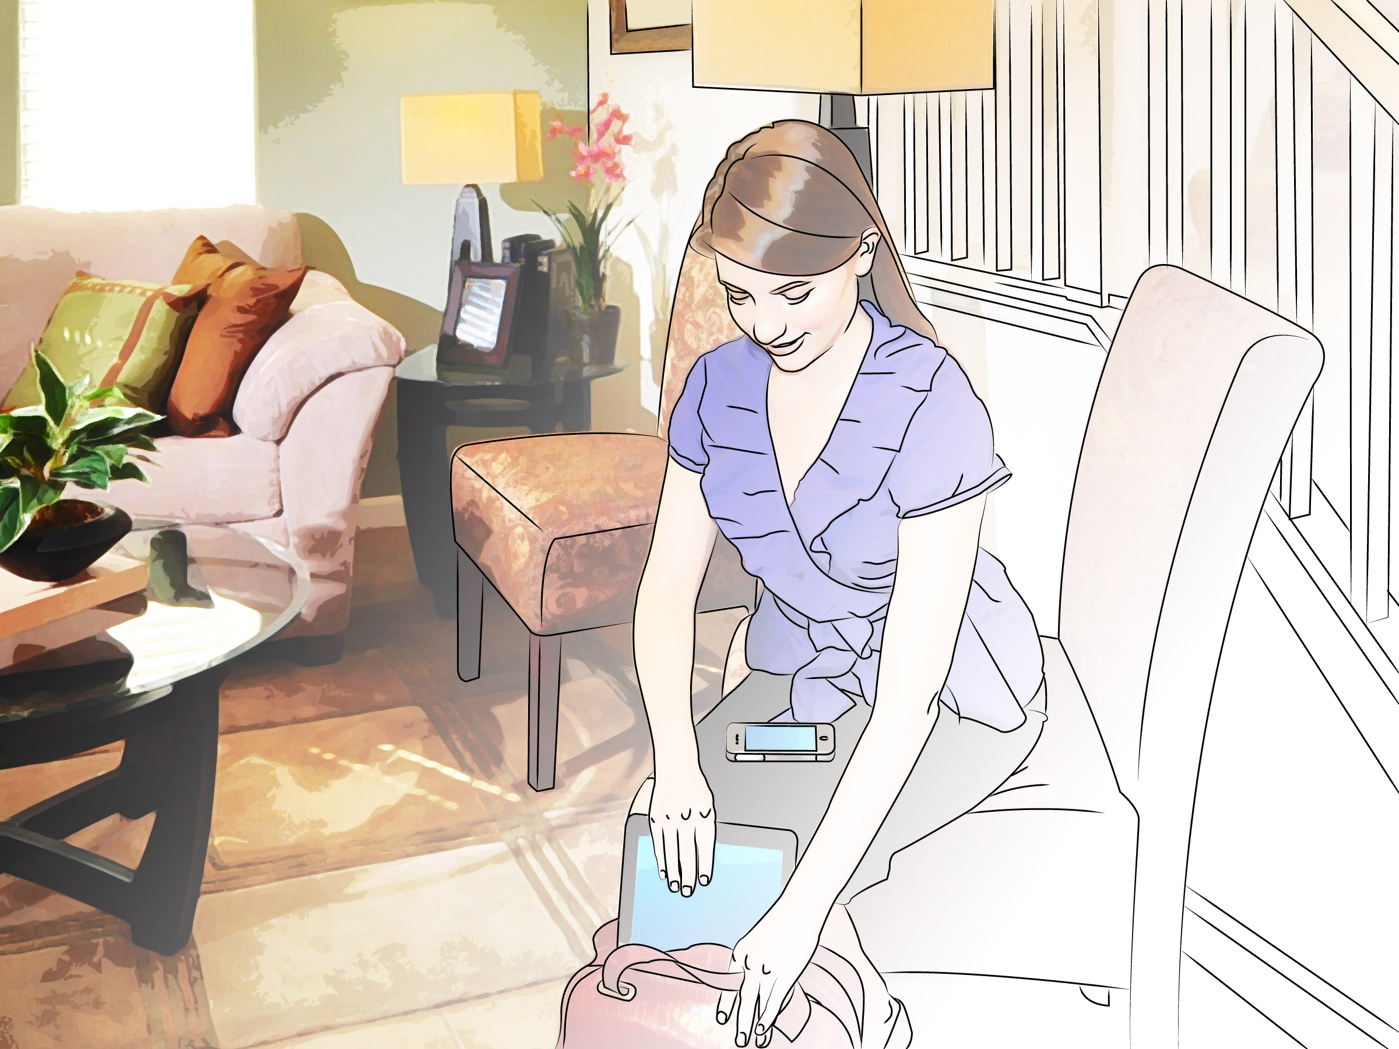
This is Lauren.
She has an important meeting at work today.
Image Source: Thinkstock/USDOT

Slide 3
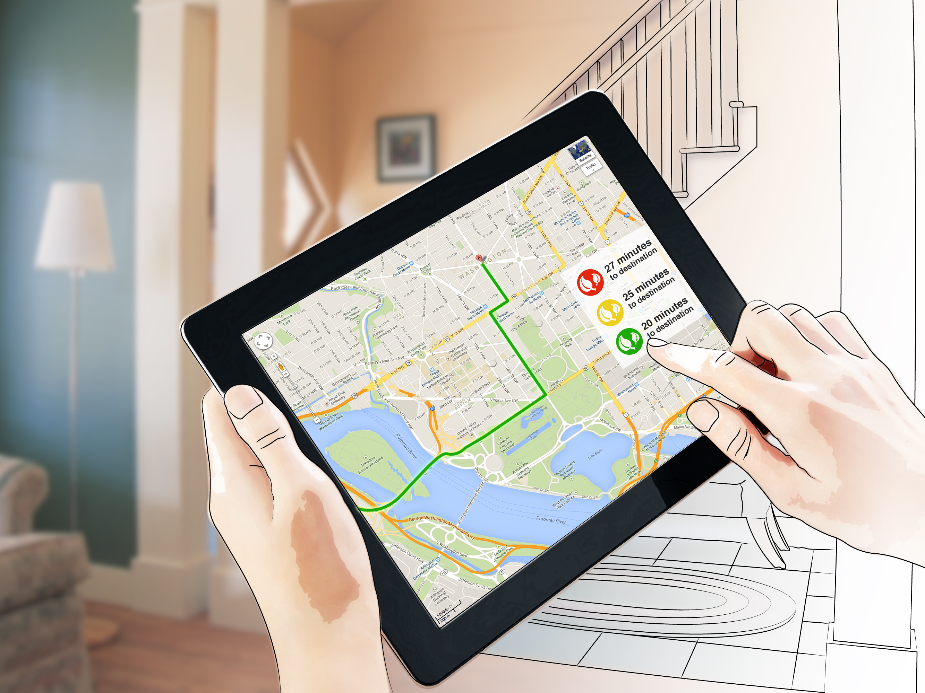
Lauren is heading to work on a code red air quality day. She looks at her iPad and chooses the least polluting travel route which has fewest number of stops and starts. Unlike today’s applications, Lauren is able to get multimodal travel data at one time.
Image Source: Thinkstock/USDOT

Slide 4
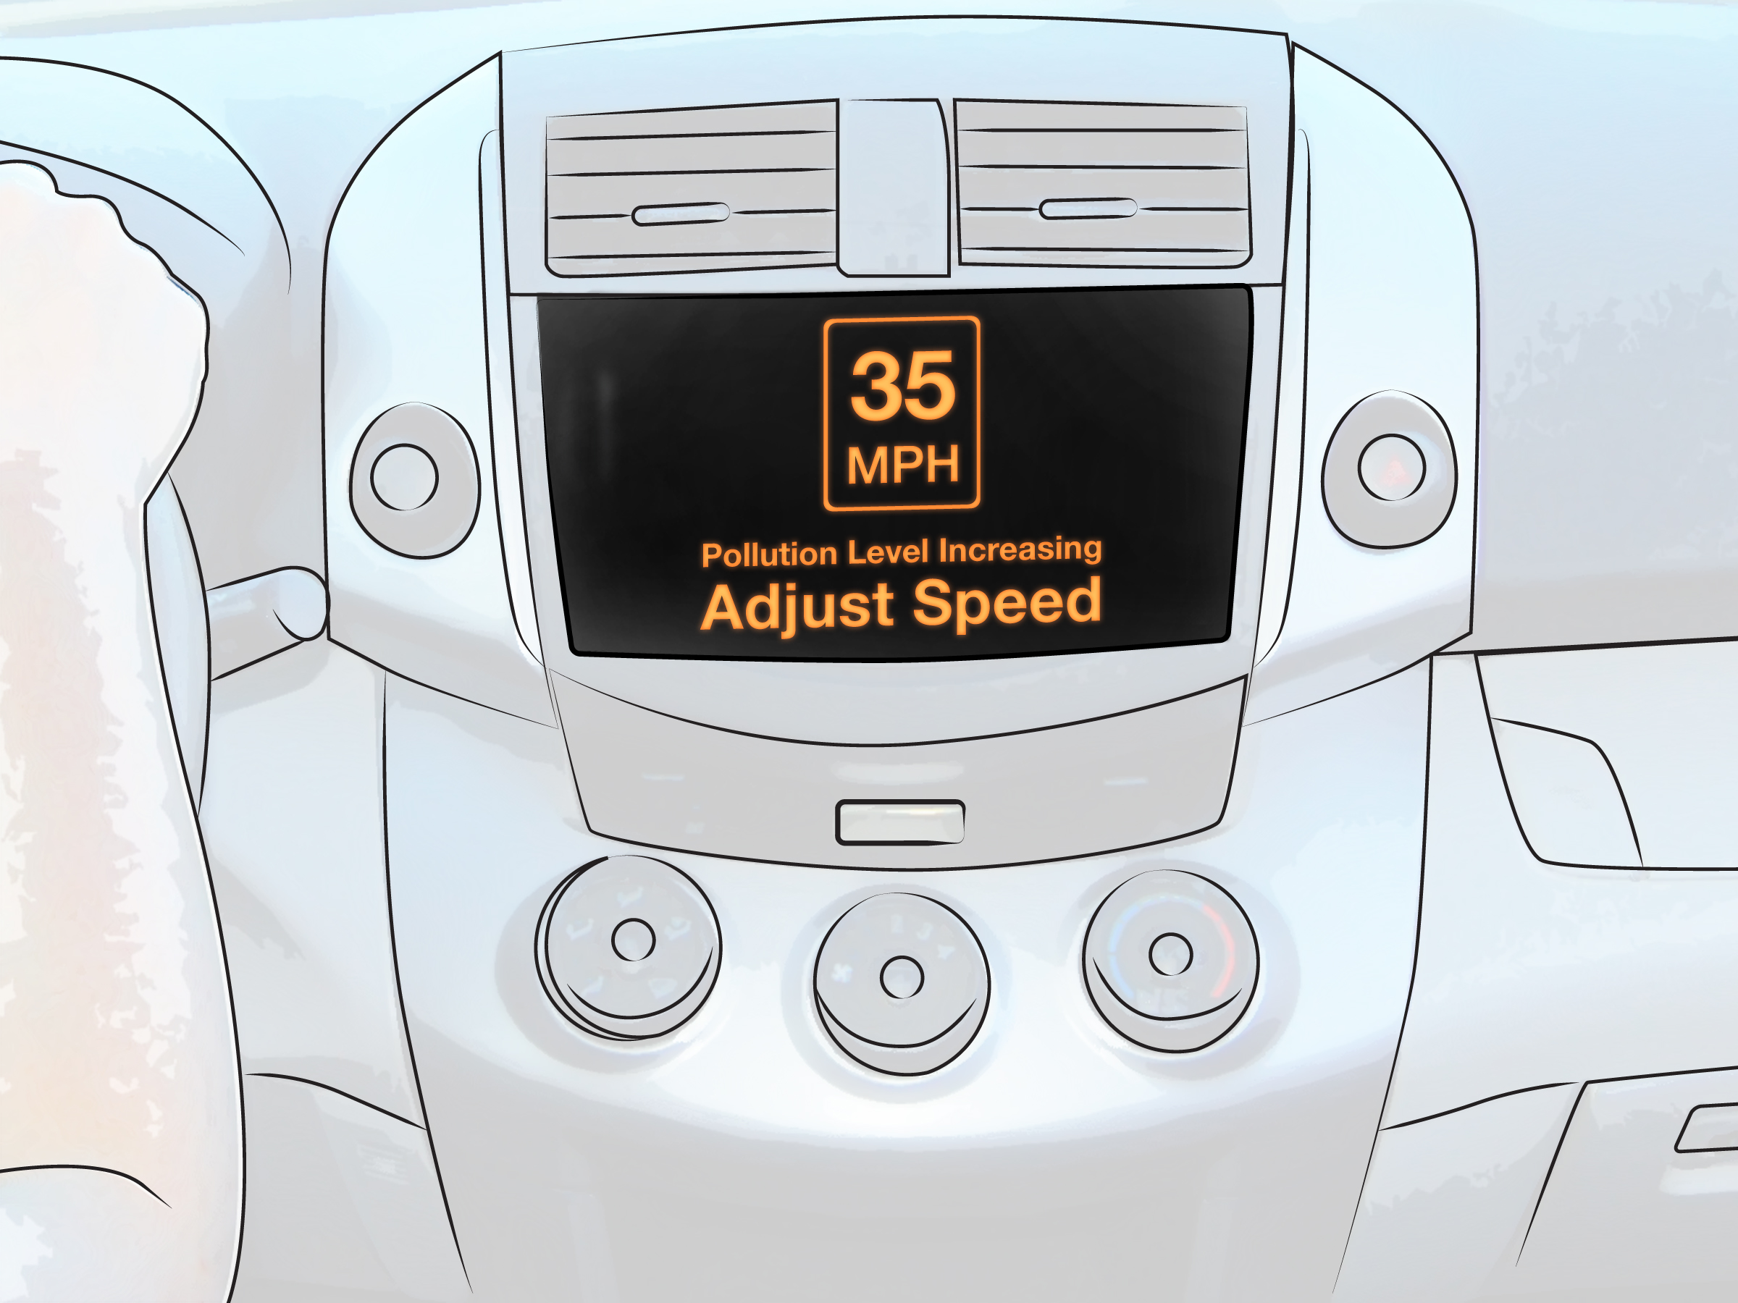
Because of increasing pollution levels along Lauren’s route, she is asked to adjust her speed to avoid a potential traffic jam. Lauren’s car will give off fewer emissions.
Image Source: Thinkstock/USDOT

Slide 5
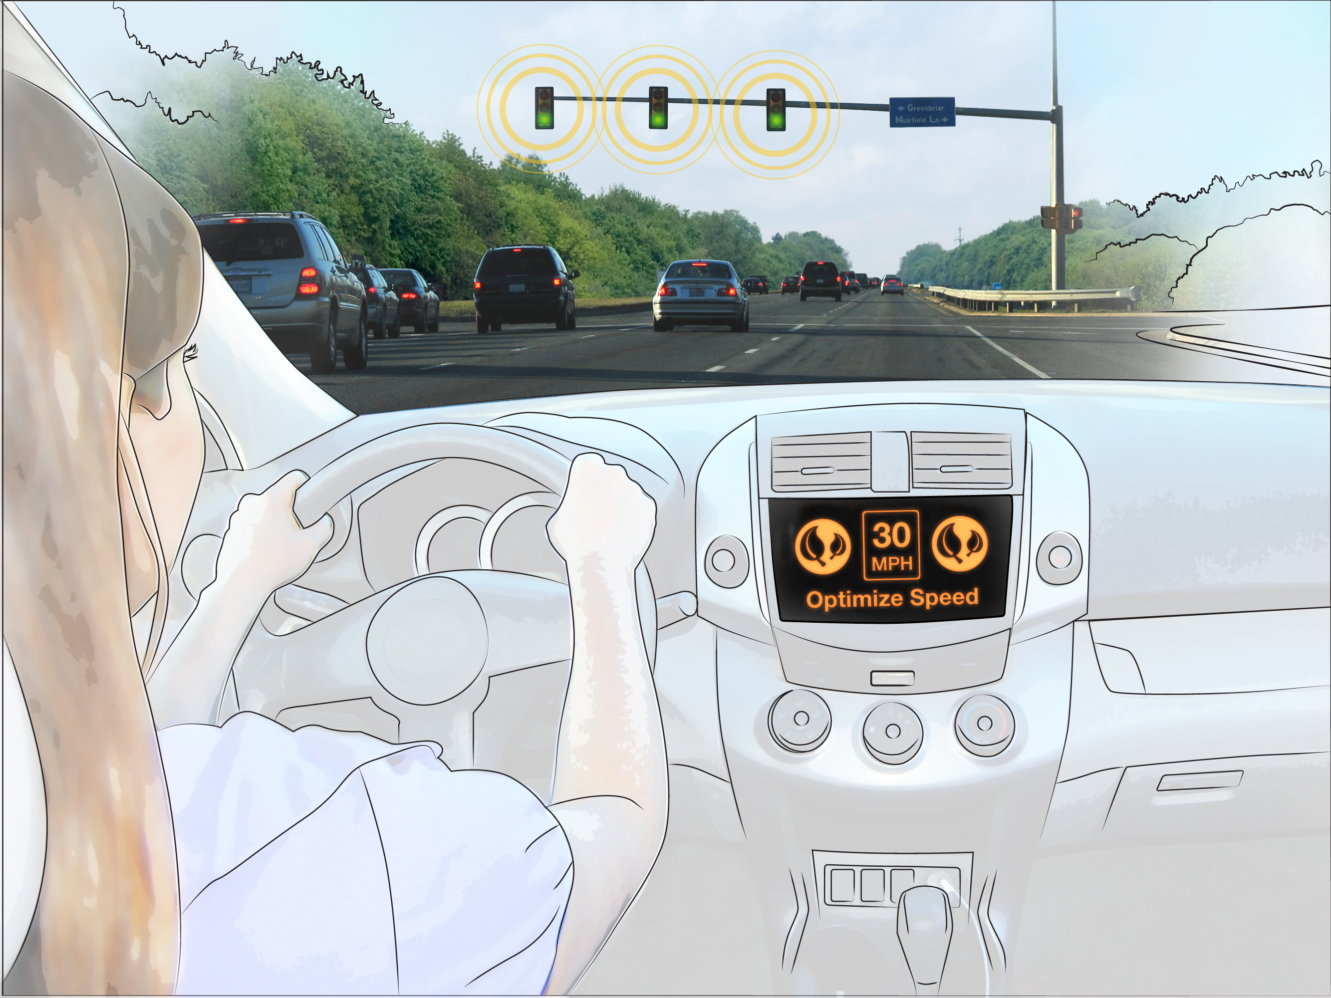
The message telling Lauren to adjust her speed is coming from a special Eco-Traffic Signal that helps optimize vehicle speeds so that they produce fewer emissions.
Image Source: Thinkstock/USDOT

Slide 6
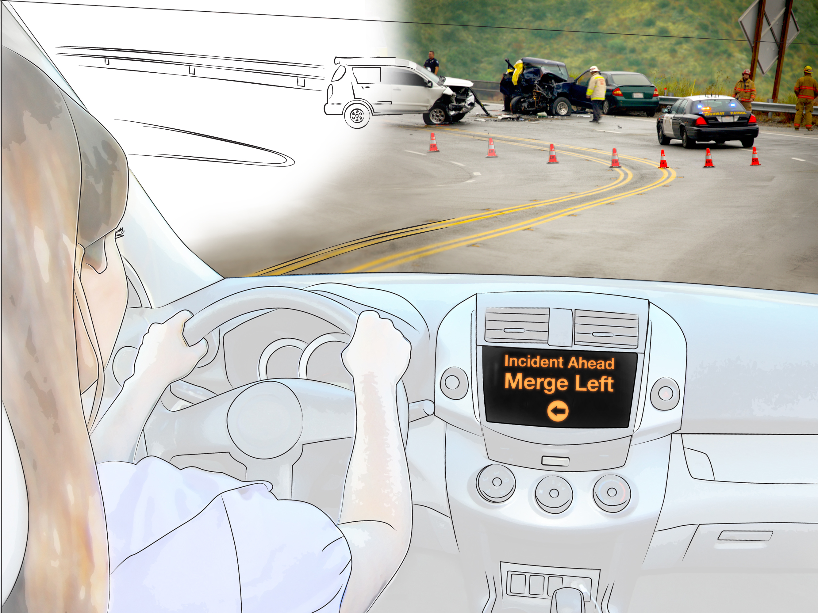
Lauren sees an incident ahead.
First responders are already on the way because of a wireless mayday message sent from the crashed vehicle.
Image Source: Thinkstock/USDOT

Slide 7
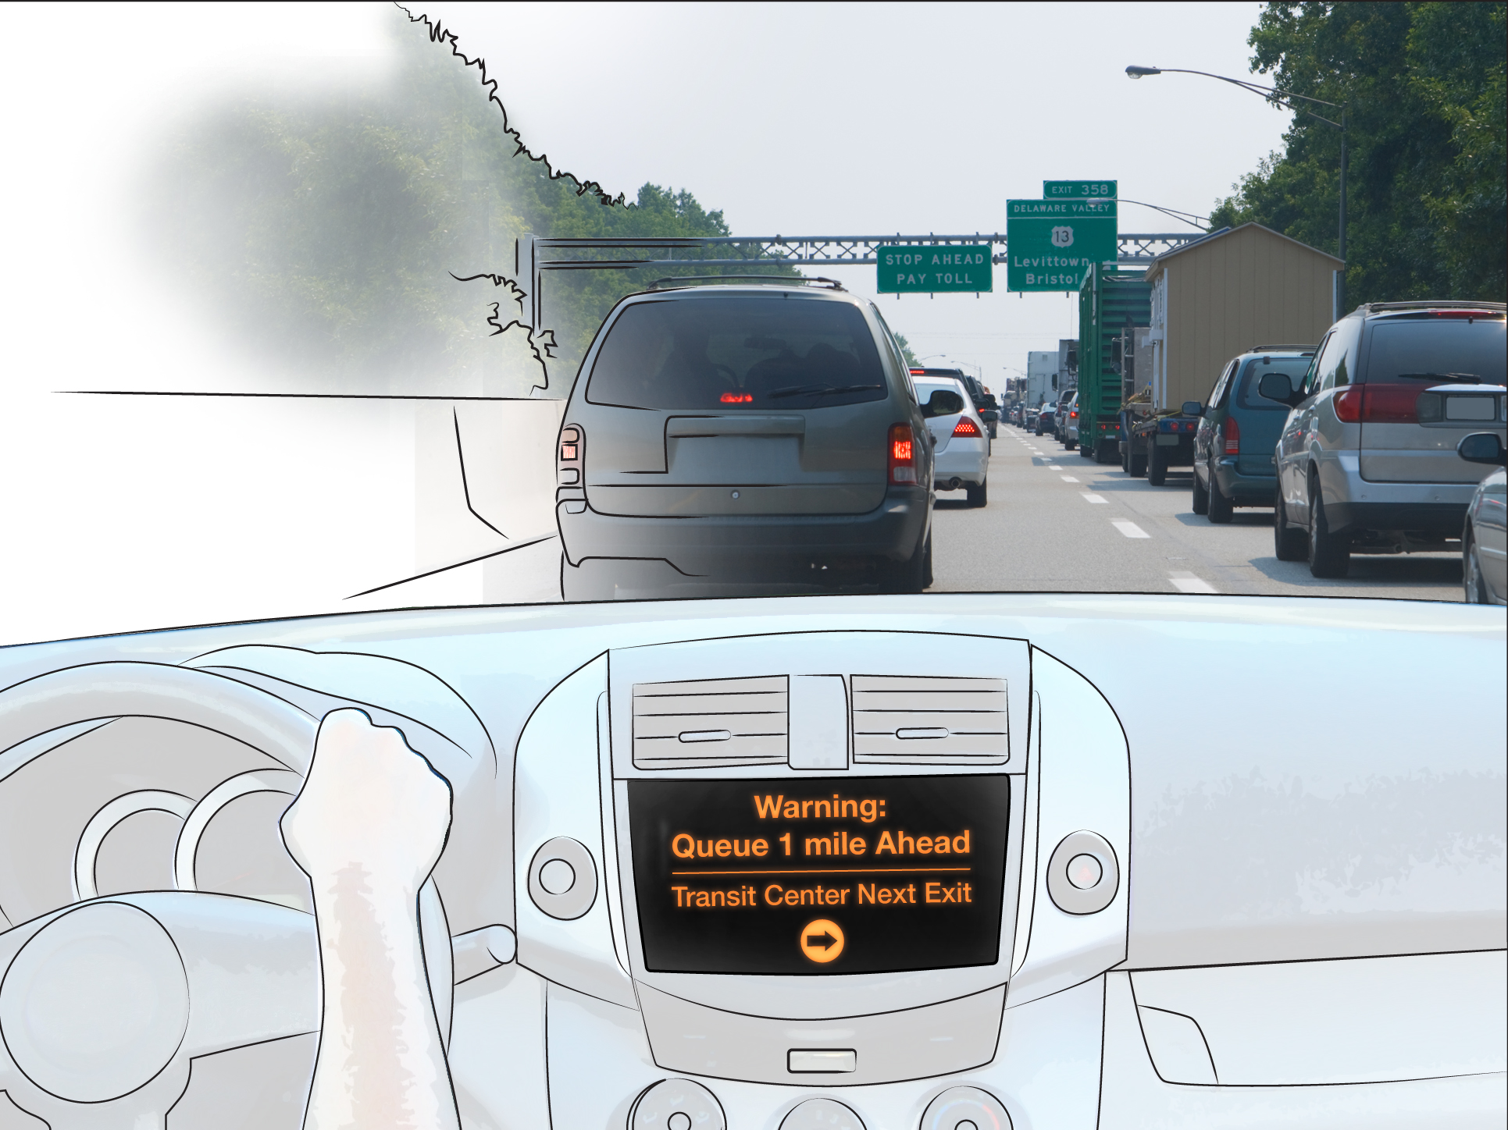
Lauren’s car warns her of a queue ahead due to stalled vehicle on the right lane, and suggests an alternate route that includes parking and public transportation.
Image Source: Thinkstock/USDOT

Slide 8
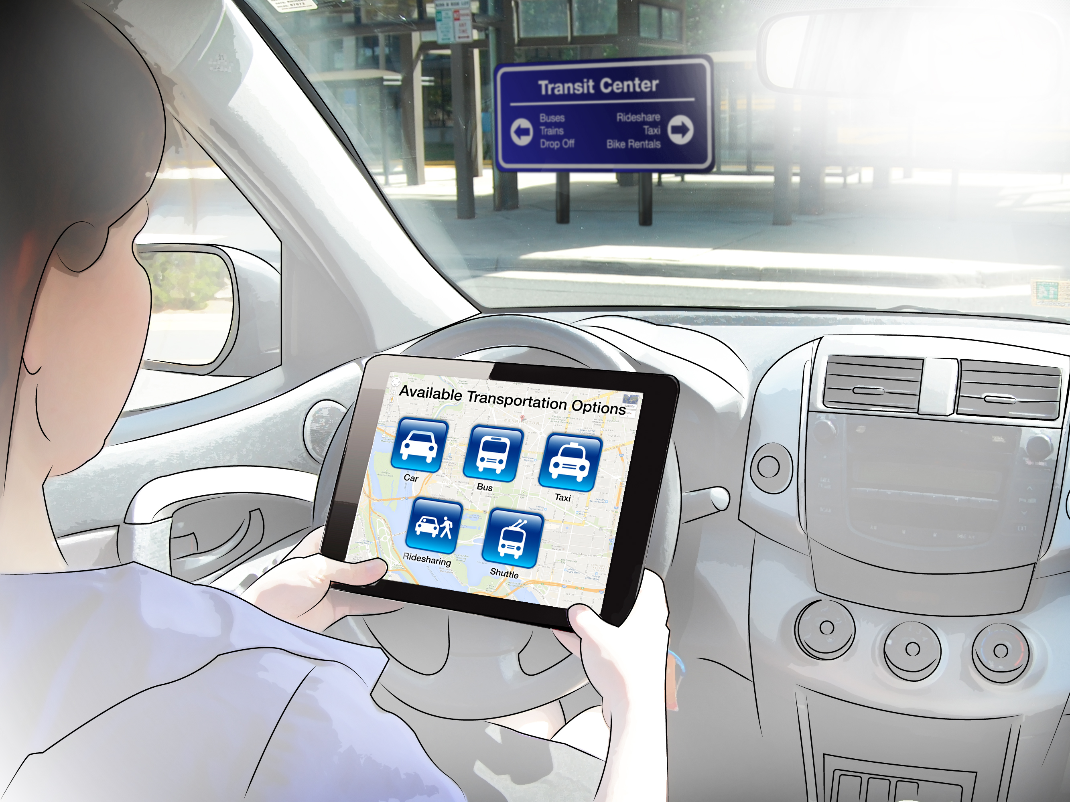
Lauren parks her car and uses an app on her tablet to determine all the public transportation options available to her, including bus, subway, commuter rail, paratransit, ride sharing, and taxi.
Lauren says bye to her car and takes the train.
Image Source: Thinkstock/USDOT

Slide 9
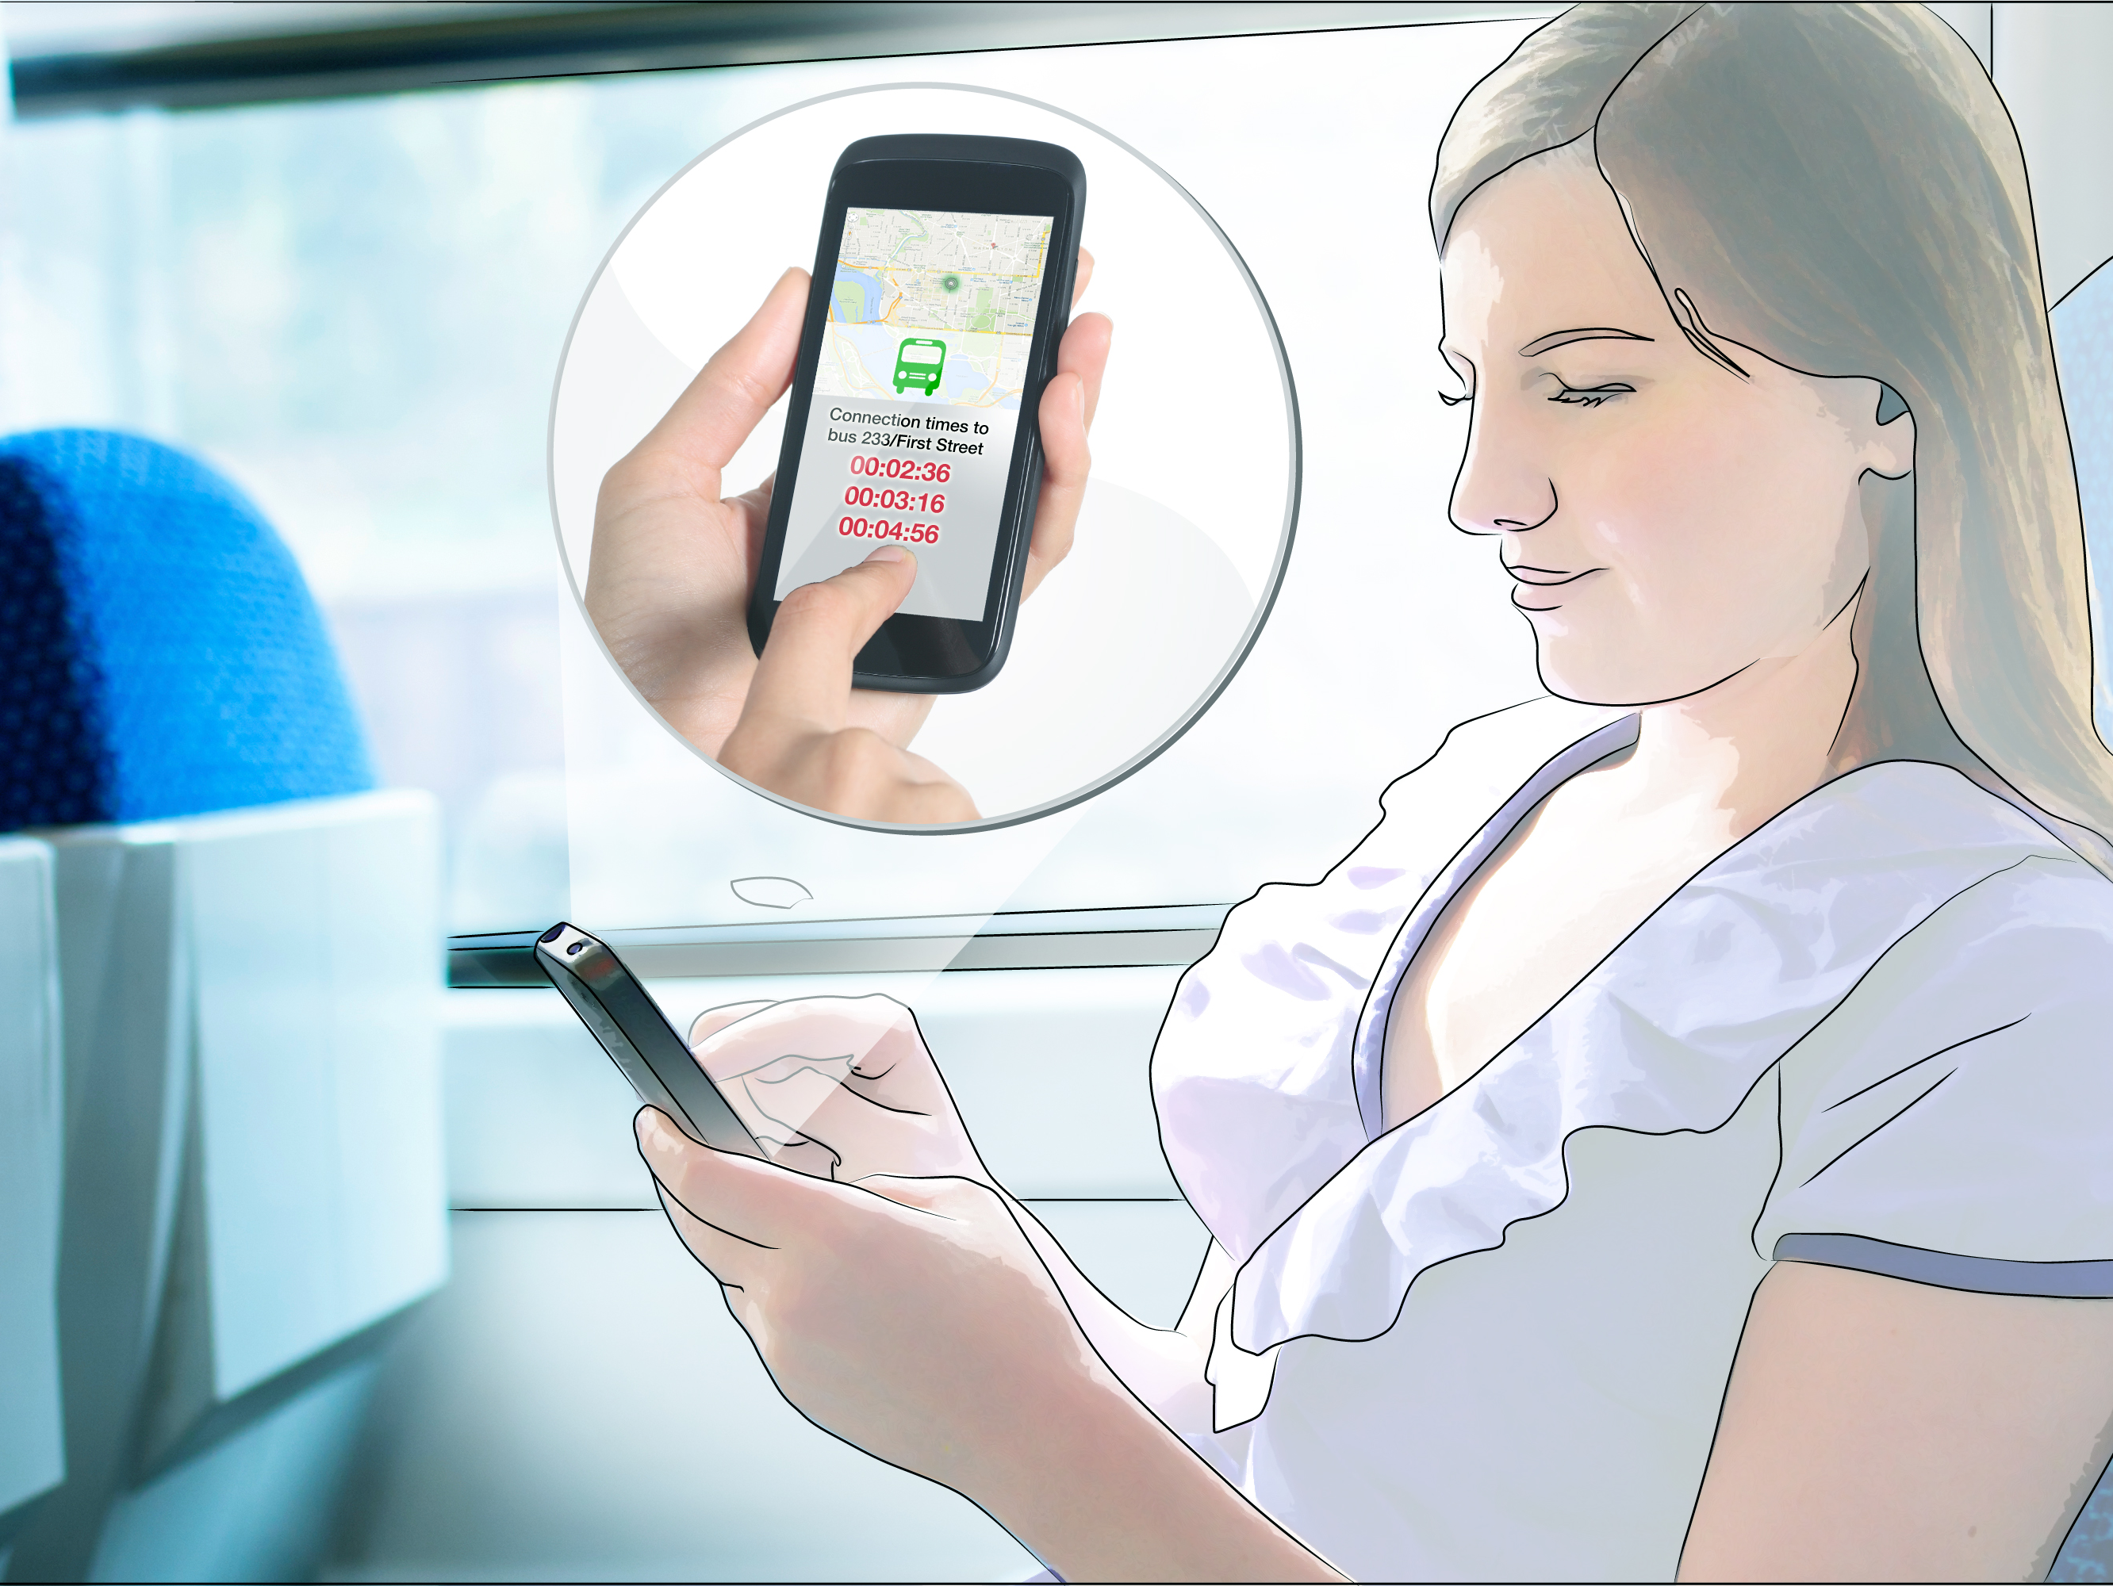
While on the train, Lauren uses her smartphone to check her next connection.
Image Source: Thinkstock/USDOT

Slide 10
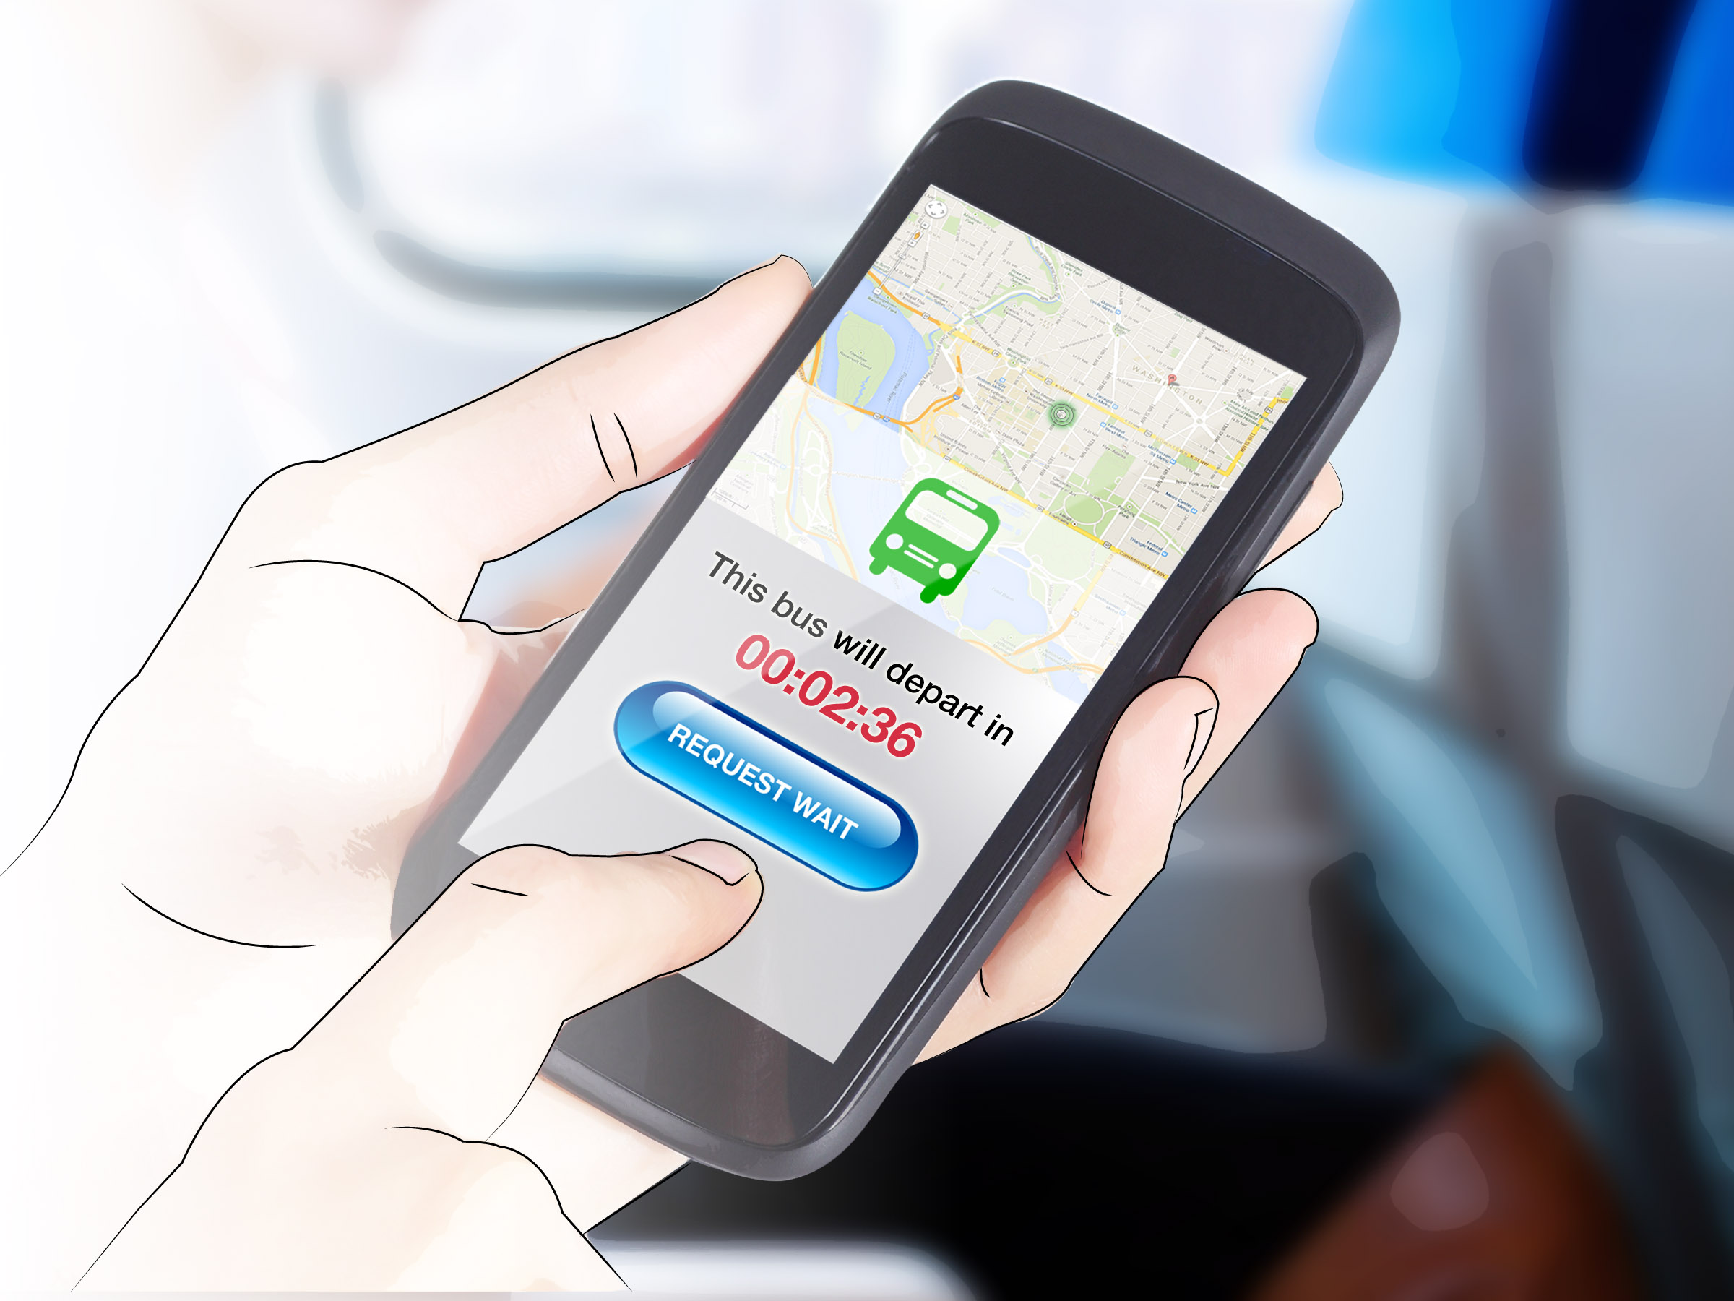
Unfortunately, the train is running behind schedule and Lauren could miss her connecting bus.
Lauren sends a request for the bus to wait.
Image Source: Thinkstock/USDOT

Slide 11
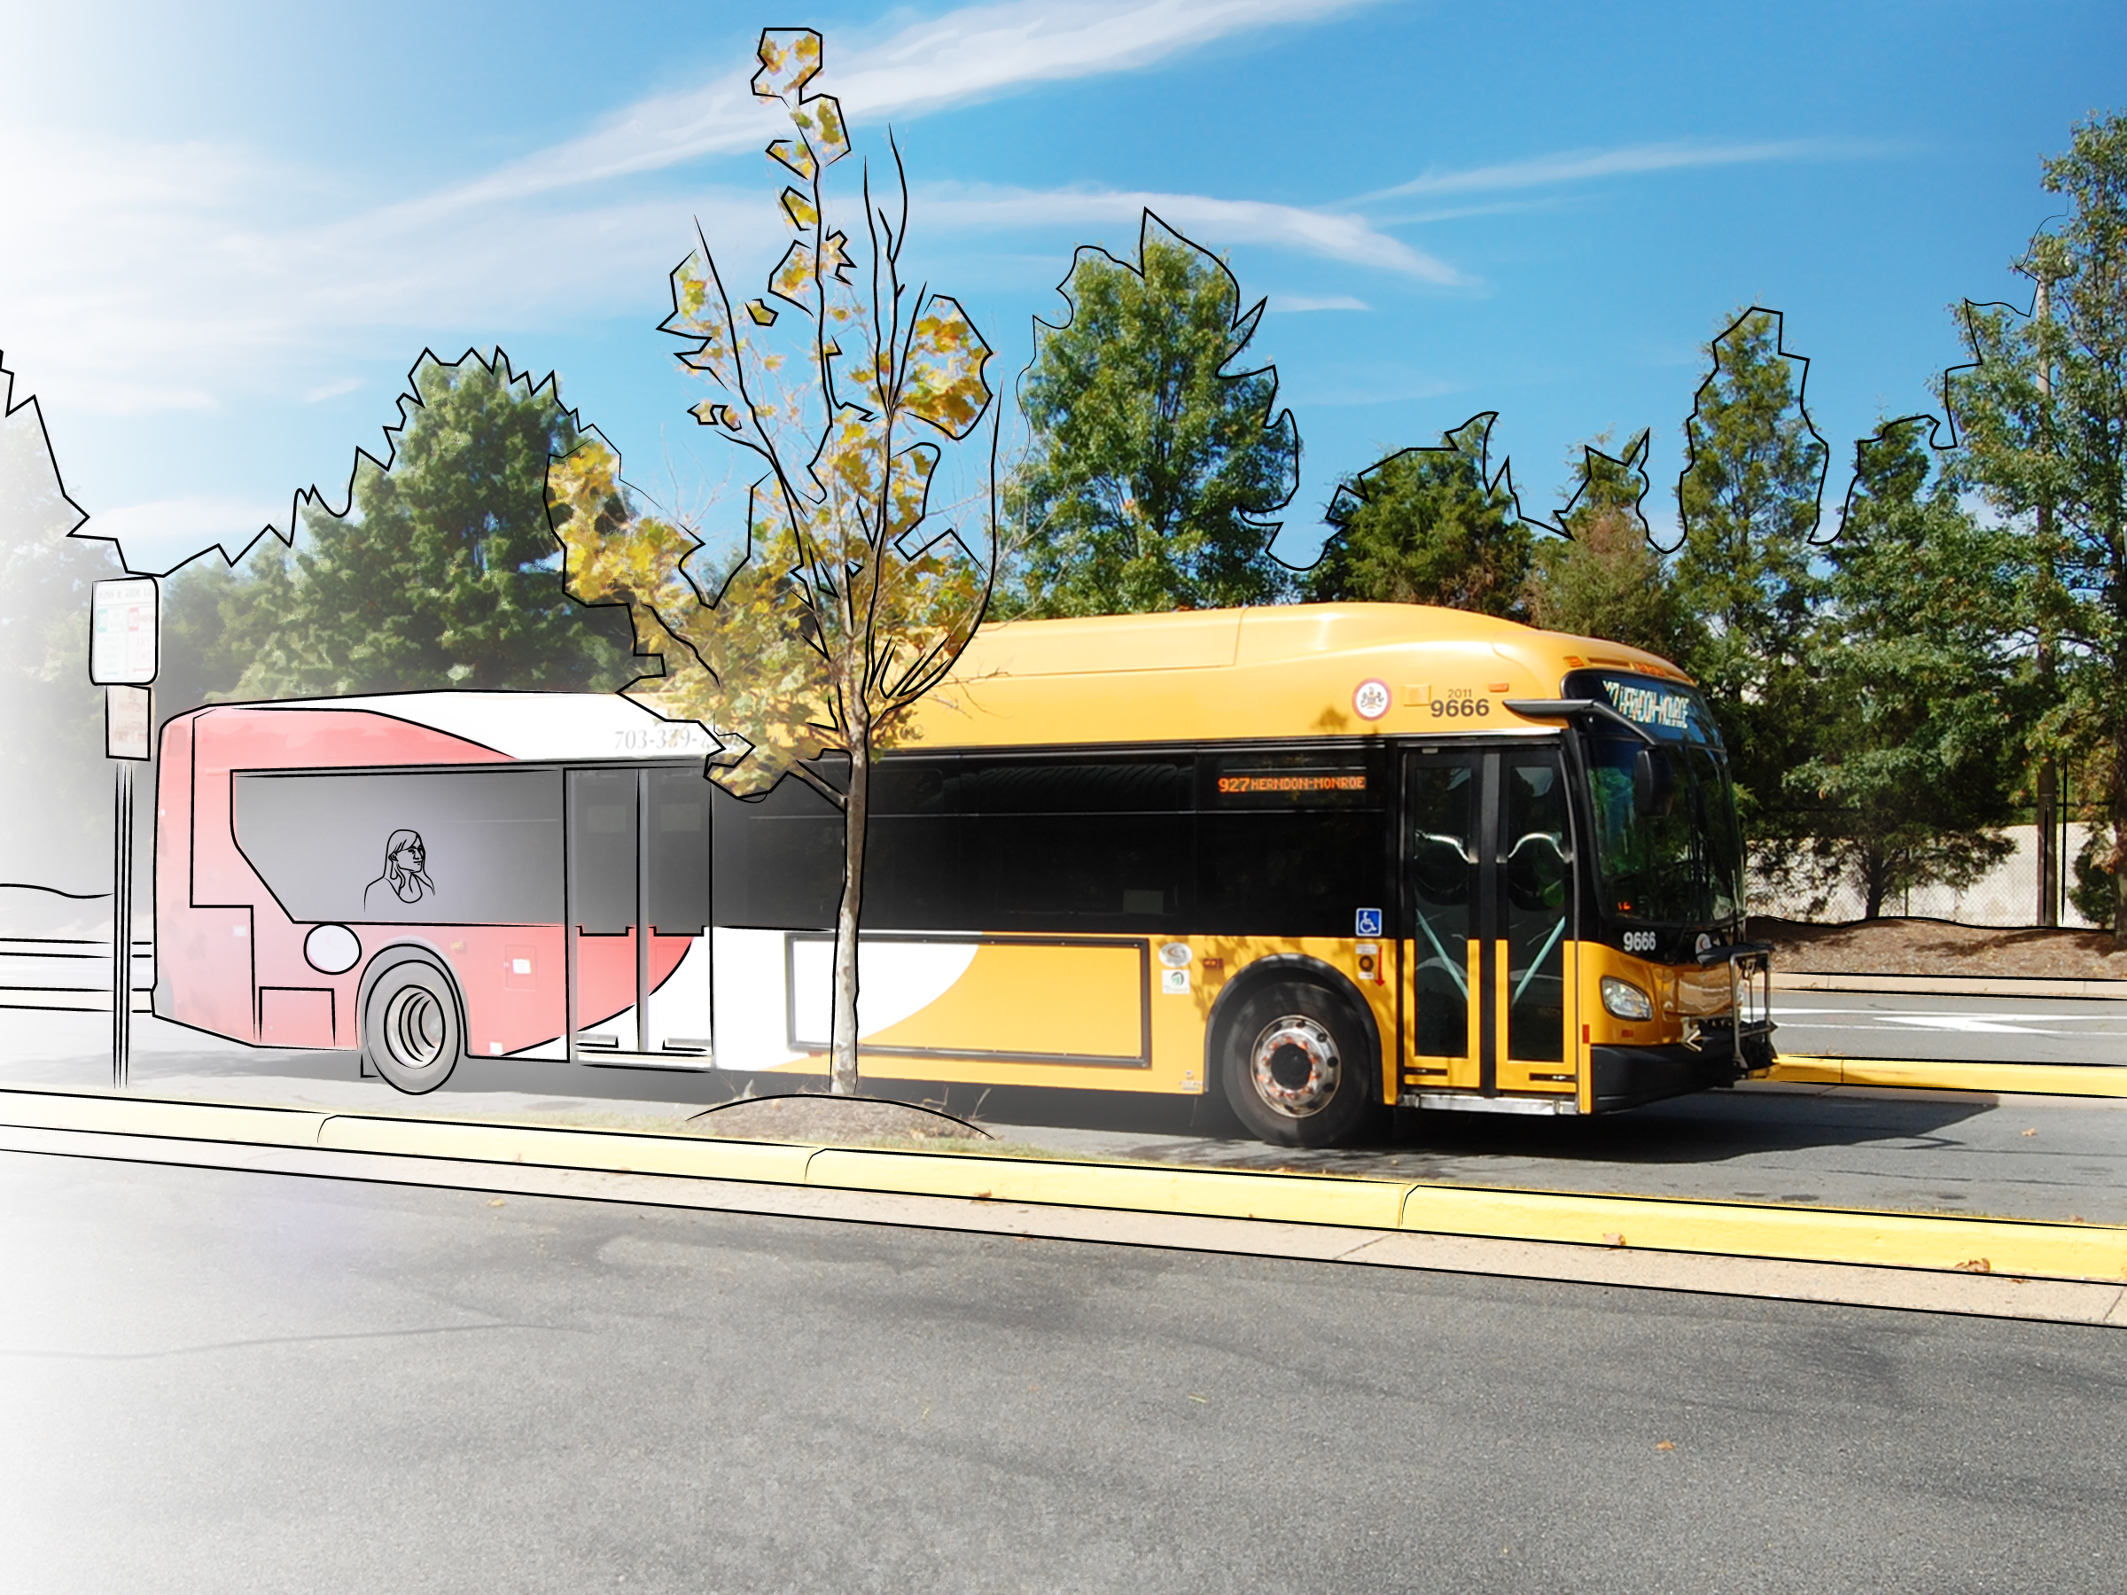
Lauren and twelve other rail passengers all request the bus to wait so they can make their connection. Given this information, and the fact the bus is running slightly ahead of schedule, the bus driver waits for all connecting passengers to board before departing.
Image Source: Thinkstock/USDOT

Slide 12
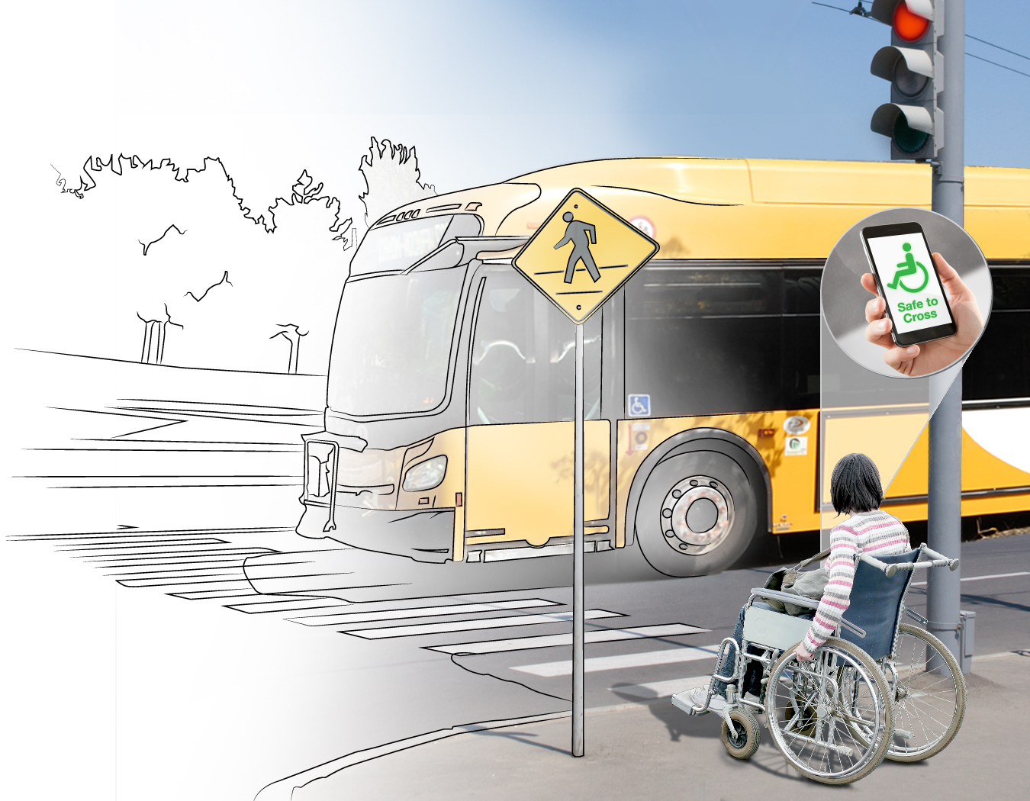
A disabled pedestrian uses her phone to communicate with surrounding vehicles and signal system to ensure she has time to cross safely. Lauren is concerned her bus is running late. However, the bus and signal system coordinate to ensure the bus has a green signal when it arrives at the next intersection.
Image Source: Thinkstock/USDOT

Slide 13
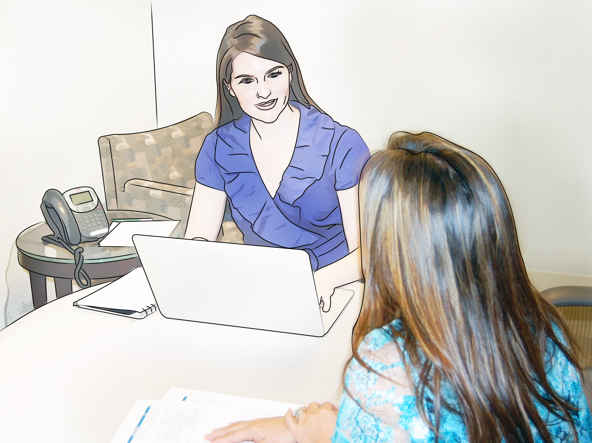
Thanks to a connected transportation system in constant communication, Lauren has made it to
her meeting with minutes to spare.
Image Source: Thinkstock/USDOT

