Slide 1
Talking Transportation Technology (T3) Webinars
Tuesday, August 15, 2023 – 1:00PM
Road Weather Management and Arterial Management Part 4 of 5 in the Crowdsourcing for Operations Course via Webinar
Course developed by the Federal Highway Administration (FHWA) Every Day Counts (EDC)
Crowdsourcing for Operations

Slide 2
Talking Transportation Technology (T3) Webinars are brought to you by the Intelligent Transportation Systems (ITS) Professional Capacity Building (PCB) Program of the U.S. Department of Transportation’s (USDOT) ITS Joint Program Office (JPO)
For more information, visit: www.pcb.its.dot.gov

Slide 3
PDH Policy
The T3 Webinar Program does not officially offer Professional Development Hours (PDHs); however, your participation in a T3 Webinar may qualify as PDH-eligible activity with your licensing agency.
Upon request, the T3 Webinar Program can provide a letter verifying your attendance. Please contact T3@dot.gov to make a request.
For more information, please visit: https://www.pcb.its.dot.gov/t3_pdh_policy.aspx

Slide 4
Ask a Question / Make a Comment
Use the Chat Pod
Click on Chat icon on your screen
Submit your question or comments in the Chat window
Questions/comments will be addressed after the last presentation, as time permits

Slide 5
Road Weather Management and Arterial Management Part 4 of 5 in the Crowdsourcing for Operations Course via Webinar
Intelligent Transportation Systems Joint Program Office (ITS JPO) Professional Capacity Building (PCB) Program Presents
August 15, 2023
Course developed by the Federal Highway Administration (FHWA) Every Day Counts (EDC) Crowdsourcing for Operations Innovation and delivered by the FHWA Office of Operations

Slide 6
DISCLAIMER
The U.S. Government does not endorse products or manufacturers. Trademarks or manufacturers’ names appear in this presentation only because they are considered essential to the objective of the presentation. They are included for informational purposes only and are not intended to reflect a preference, approval, or endorsement of any one product or entity.
This presentation was created and is being co-presented by both FHWA and outside parties. The views and opinions expressed during this presentation are the presenters' and do not necessarily reflect those of FHWA or the U.S. Department of Transportation (USDOT).
Except for the statutes and regulations cited, the contents of this presentation do not have the force and effect of law and are not meant to bind the States or the public in any way. This presentation is intended only to provide information regarding existing requirements under the law or agency policies.

Slide 7
Today’s Host and Presenters
James Colyar, Host
EDC Crowdsourcing Colead FHWA Office of Operations
Stephanie Marik
Transportation Systems Performance Engineer,
Ohio Department of Transportation (DOT)
Dr. Wang Zhang
Transportation Data Program
Manager, Maricopa Association of Governments (MAG)
Jeremy Dilmore
Transportation Systems Management and Operation Engineer, Florida DOT
Source: FHWA.
Source: MAG.
Source: Ohio DOT.
Source: Jeremy Dilmore.

Slide 8
Webinar Agenda
1:05 p.m. FHWA EDC-6 Crowdsourcing Innovation and Course Background
1:15 p.m. Road Weather Management
1:35 p.m. Arterial Management
2:10 p.m. Question and Answer
2:30 p.m. Webinar Close
*EDT Time Zone
Source: Unsplash.

Slide 9
What Is Every Day Counts?
State-based innovation deployment model
Proven but underutilized innovations
2-year cycles
http://www.fhwa.dot.gov/innovation/everydaycounts/

Slide 10
EDC-6: Deepen Crowdsourcing Roots for a Bountiful Suite of Benefits
Adding data sources and applications
Improving data management
Improving archived data usage
Sharing and integrating data
Source: FHWA.

Slide 11
Crowdsourcing Course-in-a-Box
Course Goals:
Broaden understanding and knowledge about how crowdsourced data can improve transportation systems management and operations (TSMO)
Help participants consider whether specific applications of crowdsourcing may meet their organizations’ needs
Course Tools:
Editable instructor templates
Instructor materials
Course slide decks
Student materials
Source: Pixabay.

Slide 12
Whom Is the Course Targeting? Transportation Groups
Public works departments
Emergency planning
Work zone managers
Safety and planning
Traffic management centers (TMCs)
Traffic signal systems administrators
Operations
Maintenance
Consider nontraditional invitees such as policymakers, locally elected officials, administrators, or other leaders.

Slide 13
Course Is Modular by Design
Five Lessons:
Six Application Modules:
Traffic Incident Management
Traveler Information
Arterial Management
Work Zone Management
Road Weather Management
Emergency Management
Data
Sources
Application
Areas
Introduction
Data
Management
Next Steps
Source: Adapted from Pixabay.
Source: Adapted from Pixabay

Slide 14
Crowdsourcing Course Delivery by Webinar
Webinar | Date | Course Lessons and Modules
1 | May 16 | Crowdsourcing Introduction and Applications Lessons
2 | June 20 | Data Sources and Management Lessons
3 | July 18 | Traveler Information and Traffic Incident Management Modules (recording coming soon)
4 | August 15 | Road Weather and Arterial Management Modules
5 | September 19 | Emergency and Work Zone Management Modules and Next Steps Lesson

Slide 15
Summary of Webinar 3 Modules
Traveler Information
Crowdsourced data can deliver quantitative predictive travel times and offer greater details on issues affecting roadways.
Crowdsourced data can improve traveler information timeliness.
Traffic Incident Management
Crowdsourced data help detect incidents and queues quickly, reduce operator workload, and support after-action reviews.
Crowdsource data improve responder and traveler safety.
For traveler information, traffic incident management, and other TSMO strategies, crowdsourced data can expand geographic coverage and resolution.

Slide 16
Introductions
Please enter your name, agency, and job title in the chat window.
Source: FHWA.

Slide 17
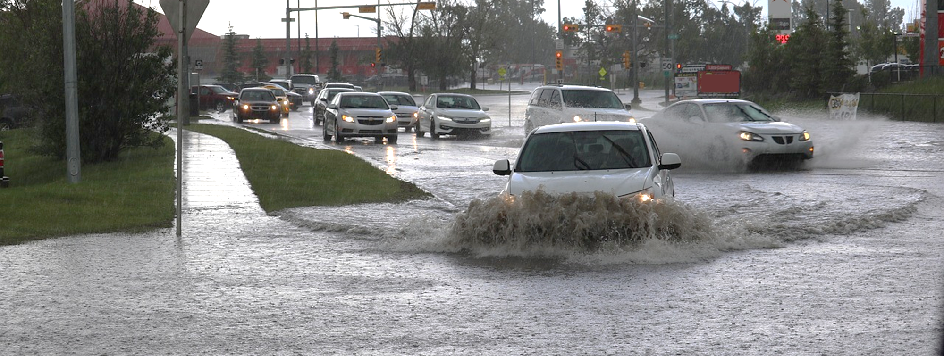
LESSON: Road Weather Management INSTRUCTOR: Stephanie Marik, Ohio DOT
Source: Pixabay.

Slide 18
Lesson Objective
Describe how crowdsourcing data can improve key aspects of road weather management
Source: Unsplash

Slide 19
Road Weather Management Challenges
“More timely, accurate and relevant information about weather-related impacts to the roads enables transportation managers and travelers to make more effective decisions.”
FHWA Office of Operations, Road Weather Management Program
Timely and accurate road-specific weather data
Understanding the safety and mobility impacts of weather
Weather-responsive decisions and outcomes

Slide 20
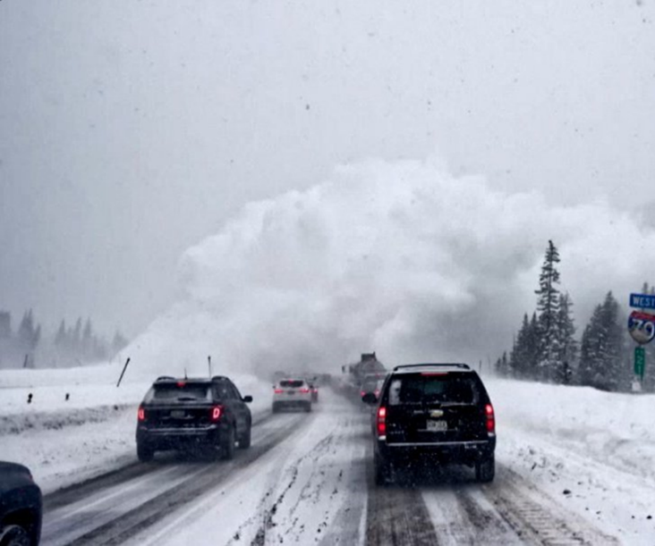
Crowdsourcing Applications for Road Weather Management
Expand weather-reporting geography and timeliness
Reduce operator workload
Facilitate real-time weather responsive strategies
Facilitate post-weather response studies
Source: Colorado DOT

Slide 21
Road Weather Management Crowdsourcing Examples
Agency | How Data is Used | Crowdsourced Data
Utah DOT | Situational awareness and traveler information | Citizen Reporter app
City of Frisco, Texas | Situational awareness and real-time weather responsive strategies | Waze®
Maine DOT | Operator workload, situational awareness and traveler information | Field mobile app
https://www.fhwa.dot.gov/innovation/everydaycounts/edc_5/docs/crowdsourcing_applications.pdf

Slide 22
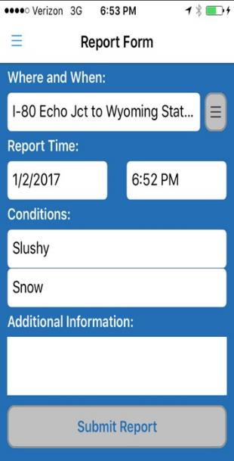
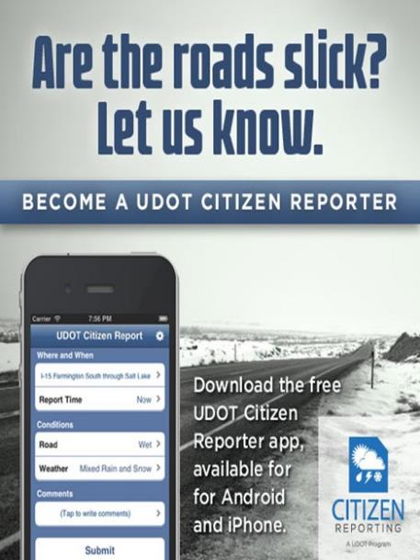
Example: Utah DOT Citizen Reporter Program
Provided a consistent way for the public and DOT workers to report road weather
Short training program promotes consistent reporting
Reports improve web, 511, and UDOT Traffic app traveler information
Source: Port Authority of New York and New Jersey
Source: Utah DOT

Slide 23
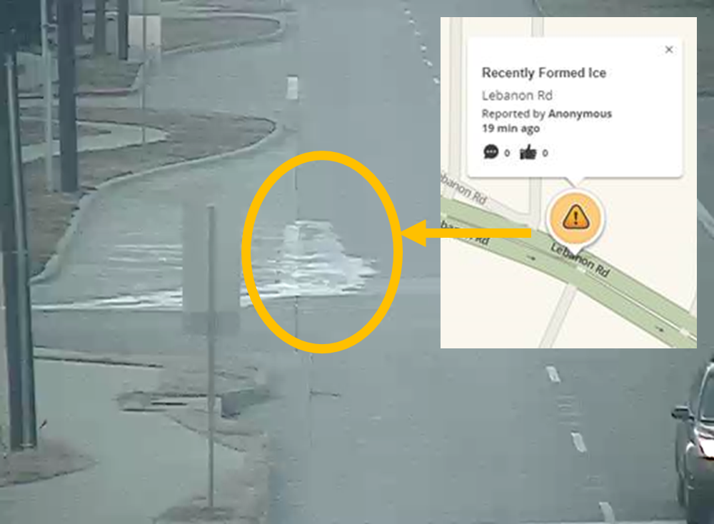
Example: City of Frisco, Texas Crowdsources Road Weather Detection
Developed a Waze® interface
Use public reports to respond to road weather events
Post Waze® events on Public Safety Computer Aided Dispatch Maps
Source: City of Frisco, Texas

Slide 24
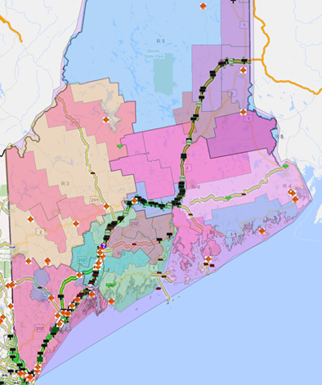
Example: Maine DOT Crowdsources Road Weather Detection within Workforce
App for road crews to report pavement, weather, and temperature (PWT) conditions
Data automated into the State’s Traffic Management Center (TMC) software
Saved TMC and Road Crew time, while standardizing reports and improving location accuracy
RWT Map
Color reflects driving conditions
Source: Maine DOT

Slide 25
Ohio DOT Road Weather Reporting
Crowdsourcing for Operations Course, August 15, 2023
Stephanie Marik, P.E.
Transportation Systems Performance Engineer
stephanie.marik@dot.ohio.gov

Slide 26
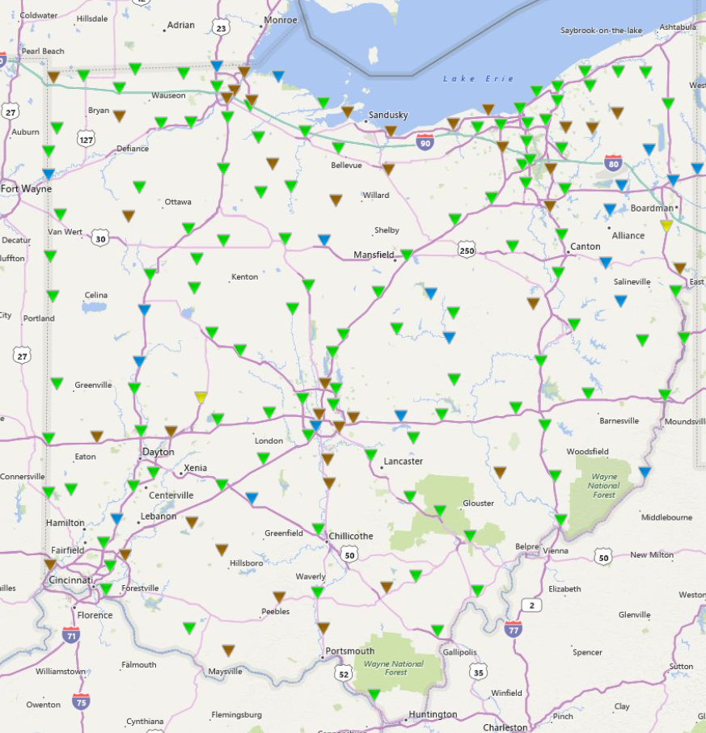
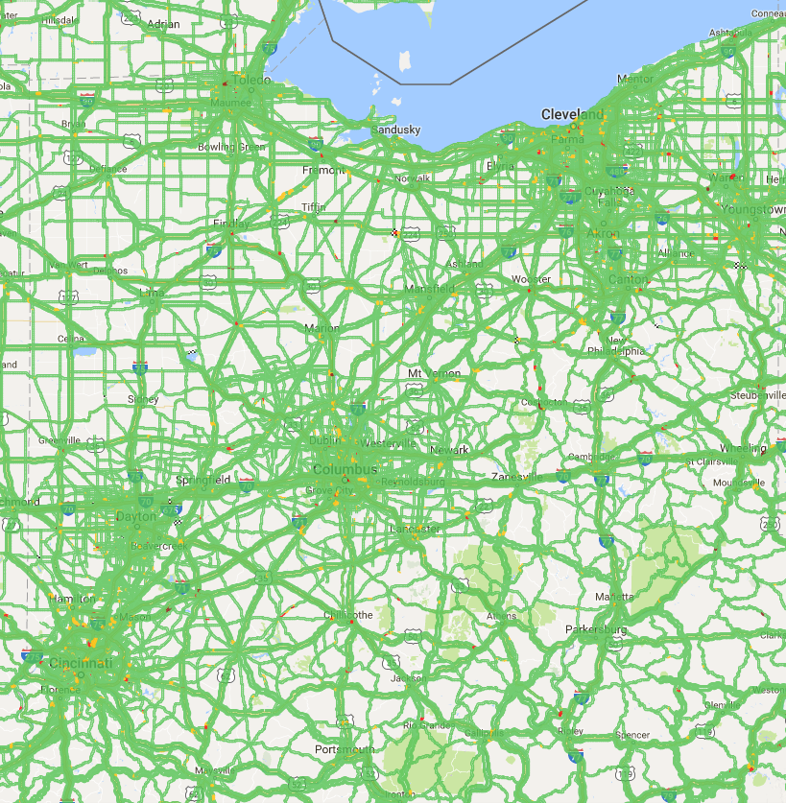
Snow & Ice – Performance Evaluator (SNIPE)
1997-98
2013-14
RWIS
INRIX

Slide 27
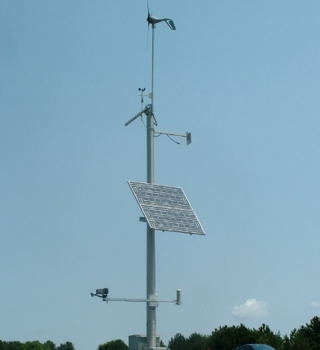
Snow & Ice – Performance Evaluator (SNIPE)
RWIS

Slide 28
1 – Event Begins
RWIS
≥40% RWIS
Detect Winter Precipitation*
≥25% INRIX
Routes with avg. speeds
at least 10 mph below
expected speeds
Snow Event
1
1
2
3
Event Begins

Slide 29
2 – Event Ends
RWIS
>60% RWIS
Stops snowing/freezing
Winds below matrix**
Snow Event
No New Event
begins within 2 hours
1
2
2
3
Event Ends

Slide 30
Weather Matrices
RWIS
*Winter Precipitation by Temp
Precip Type | Air Temperature
Snow or Freezing | ≤ 37
Unknown Precipitation | ≤ 34
Rain | ≤ 32
** Wind Matrix for Drifting Snow
Wind Type | Speed (mph) | Air Temperature
Avg Sustained | ≥ 12 | ≤ 20
Gusts | ≥ 17 | ≤ 20
Avg Sustained | ≥ 15 | 20 < T ≤ 34
Gusts | ≥ 22 | 20 < T ≤ 34

Slide 31
3 – Route Recovery
Average difference between expected and real-time speeds
≤ 10 mph
Snow Event
1
2
3
3
Route Recovered

Slide 32
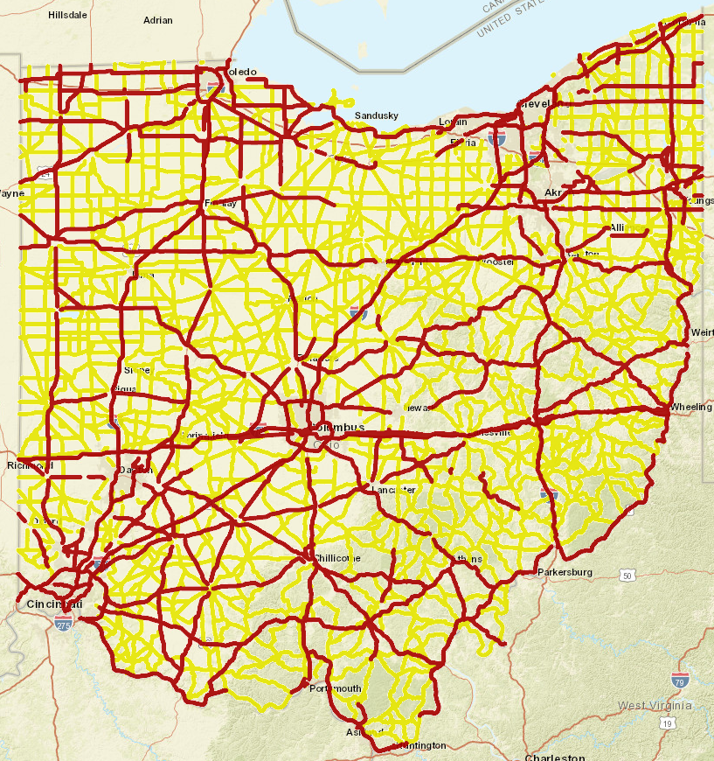
Route Level of Service
Recovery Goals
Primary = 2 hours
Secondary = 4 hours*
*Reduced service 11p-5a

Slide 33
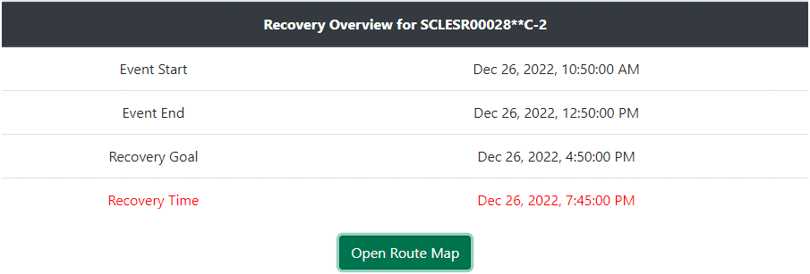
Snow & Ice – Reporting
Route Recovery Map

Slide 34
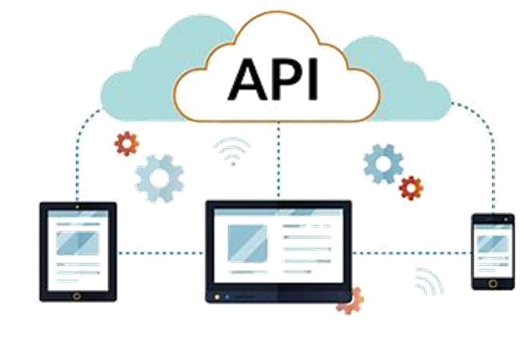
Real-Time Snow and Ice
-6
How do we communicate snow event data in real-time to better help maintenance managers?
Problems:
SNIPE looks backwards AND forwards in time
Mapping segments in real-time is not performant
Solution:
Show simplified versions of input data on a map using TSMO API & GeoEvent Server

Slide 35
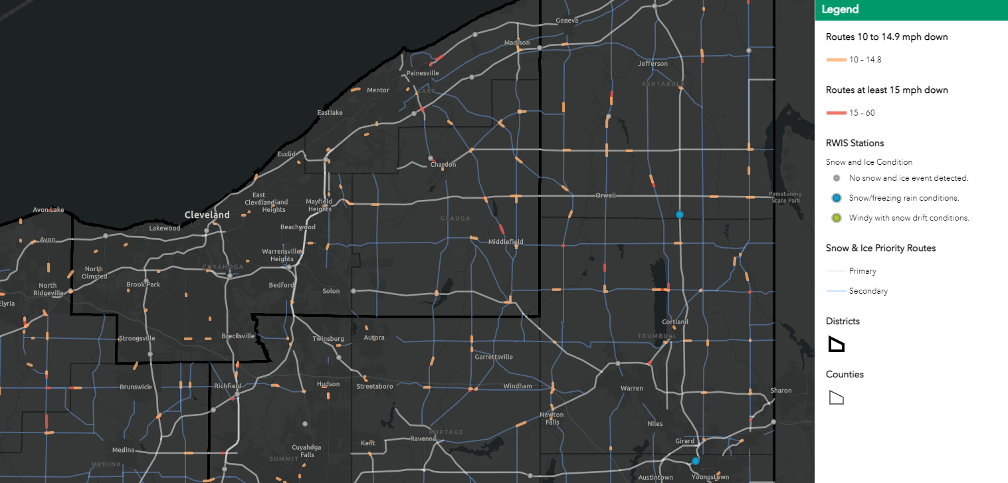
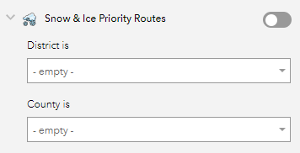
Real-Time Snow and Ice
-6

Slide 36
Making the Business Case
Benefits of purchasing crowdsourced data
Use Case | Benefit | Details
Snow & Ice Performance Report | Time Savings | Through automation (APIs & Python Scripts) reduced report processing time and resources from 2-3 people for 3-4 days to a background process that runs for ~2 hours.
Real Time Snow & Ice | Resource Allocation | Allows managers to see in real time which routes are experiencing slowdowns according to the Snow & Ice Performance metric to adjust resources where needed.

Slide 37
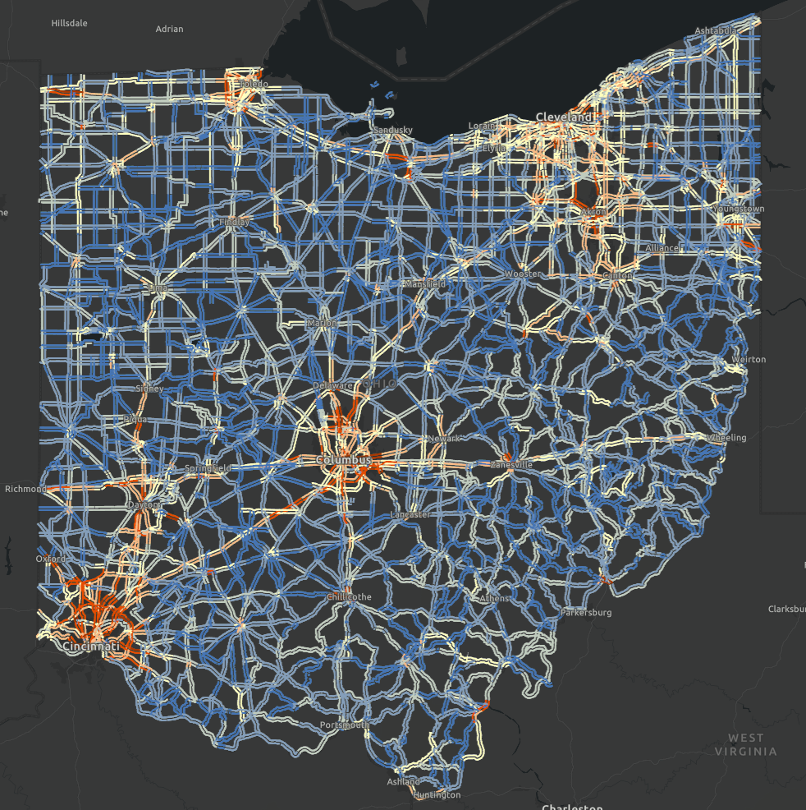
TOAST Traffic Operations Assessment Systems Tool
Bottlenecks
Travel Time
TSMO Safety
Traffic Incident Management
Traffic Volume Data

Slide 38
Knowledge Check
How does crowdsourcing data improve key aspects of road weather management?
Expand weather-reporting geography and timeliness
Facilitate real-time weather responsive strategies
Facilitate post-weather response studies
All of the above
D. All of the above
Source: Unsplash

Slide 39
LESSON: Arterial Management INSTRUCTOR: Dr. Wang Zhang, MAG and Jeremy Dilmore, Florida DOT
Source: Pixabay.

Slide 40
Lesson Objective
Describe how crowdsourcing data can improve key aspects of arterial management.
Source: Unsplash.

Slide 41
Arterial Management Challenges
“Advance the use of objectives and performance-based approaches to traffic signal management, to improve design, operations and maintenance practices, resulting in increased safety, mobility and efficiency for all users.”
Federal Highway Administration Office of Operations, Arterial Management Program
Knowing when traffic signal timing plans require updating
Measuring impacts from traffic signal maintenance or new arterial infrastructure
Adapting signal control to real-time traffic needs

Slide 42
Crowdsourcing Applications for Arterial Management
Performance-based rather than fixed calendar-based retiming.
Continuous monitoring rather than sampling for performance.
Measuring improvement effects.
Proactive ​signal response.
Source: Unsplash

Slide 43
Crowdsourced Data Uses for Arterial Management
Dr. Wang Zhang
Transportation Data Program
Manager, Maricopa Association of Governments (MAG)

Slide 44
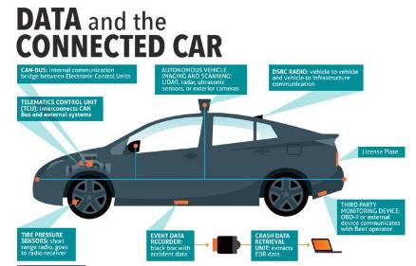
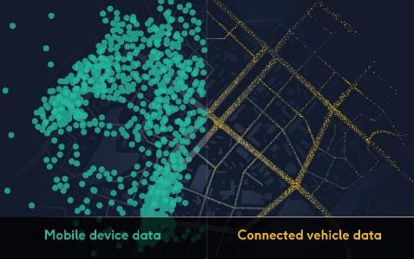
New Mobility Data – Connected Vehicle (CV) Data
From connected vehicle sensors
Vehicle trajectory updated every 3-sec with high precision:
Reporting: GPS position, speed, heading direction
Derivatives:
Origin-Destination
Path choice
Acceleration/deceleration
Intersection measures such as control delay, arrival on green, and split failure
Passenger cars only (Sedans, SUVs, Pickups), newer cars (2015 and later), from certain OEM
Penetration rate varies by region
Short-term future unclear

Slide 45
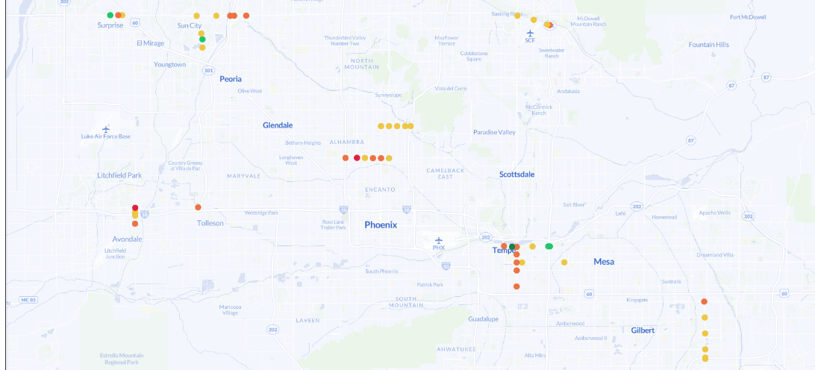
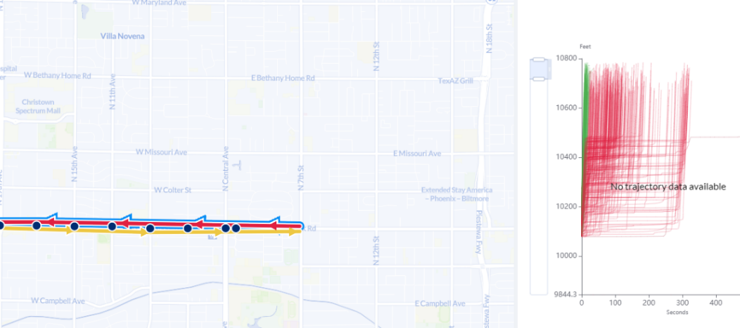
How MAG Uses Connected Vehicle (CV) Data in Arterial Management
60% of VMT in the region travels on arterial network
Compared CV data application with floating car method in measuring arterial congestion
Identified values in CV data to help monitor arterial traffic at intersection and corridor level
Piloting INRIX signal analytics with MAG member agencies, monitoring intersection delay and optimizing traffic signal operation

Slide 46
Floating Car vs. Connected Vehicle Data
Floating Car Trajectory
Connected Vehicle Trajectory

Slide 47
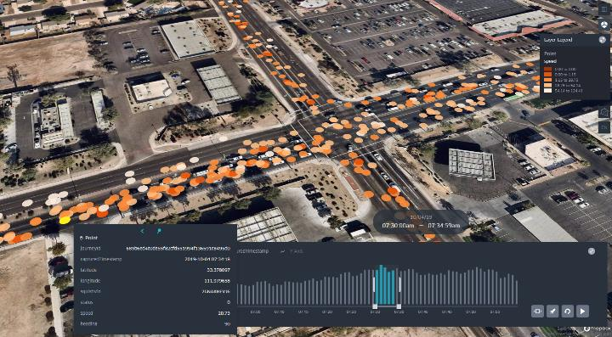
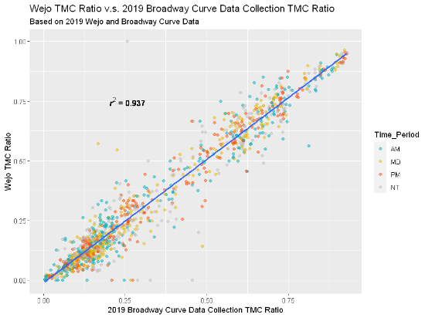
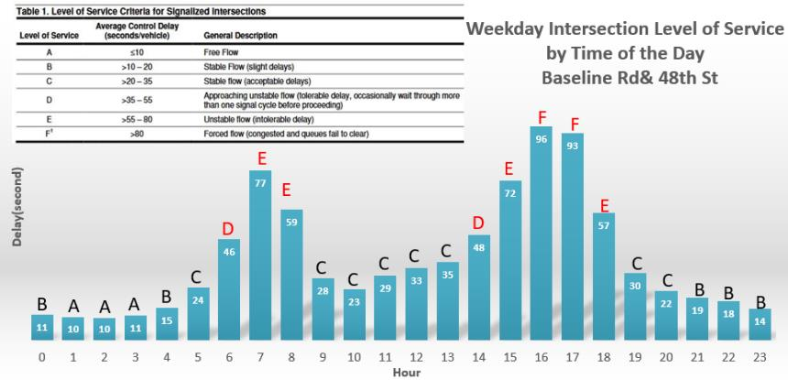
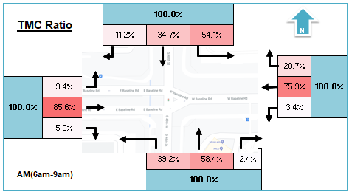
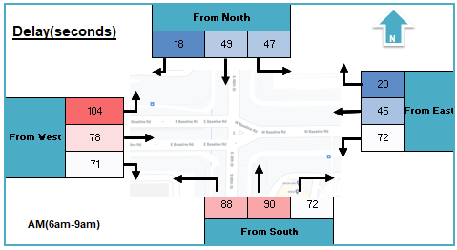
Intersection Analysis
Vehicle Movement Data
- 3-sec resolution, 24/7 coverage in the region
- High-resolution vehicle trajectory: speed, location, travel direction
Sample rate: 4-6% of total traffic
Converting Data to Intersection Measurement
Technical Advantage
High consistency to data collected by traditional methods
Broader spatial-temporal coverage
Continuous monitoring
Lower cost
Turning movement count (TMC) ratio
Travel delay (control delay and stop delay) by turning movement
Level of Service (LOS)
Queue length, percent arrivals on green (POG)
Intersection congestion profile by time of day and by date
47

Slide 48
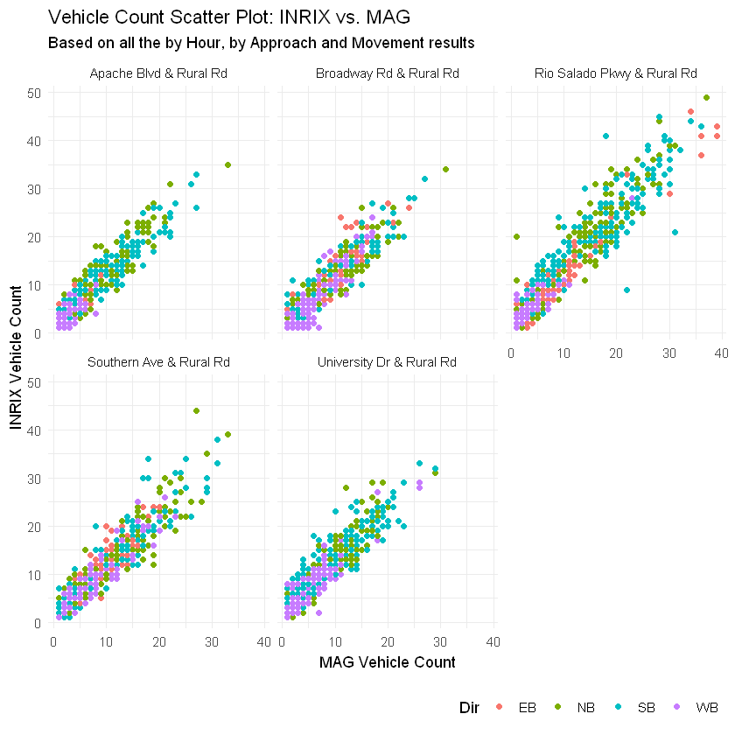
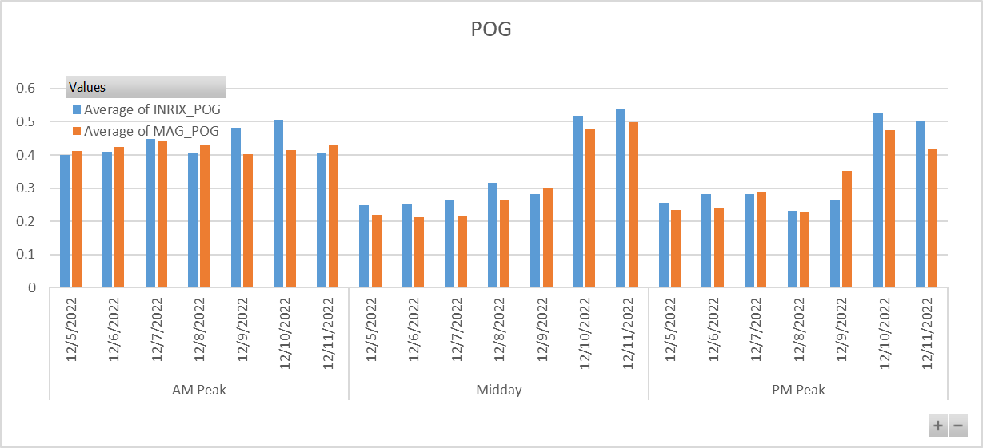
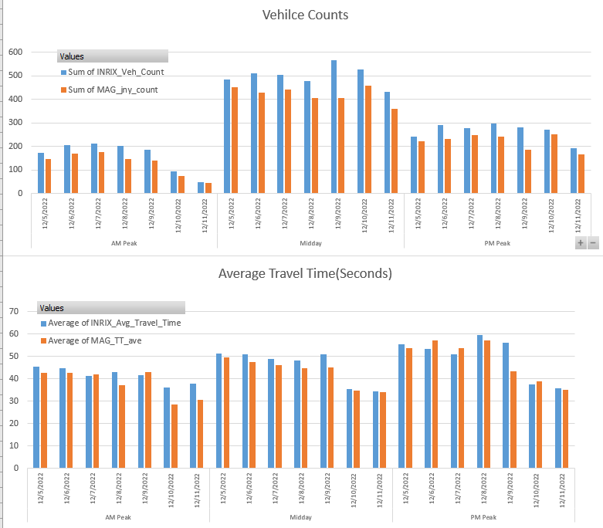
INRIX Signal Analytics Pilot

Slide 49
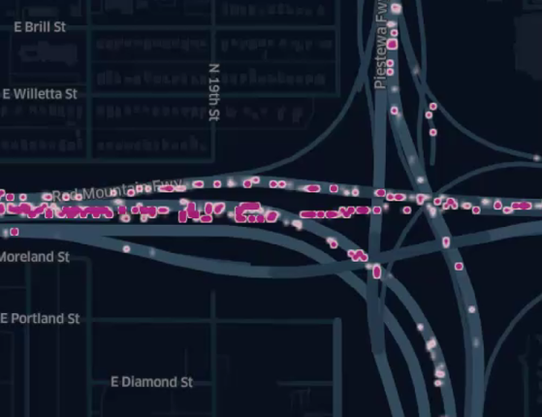
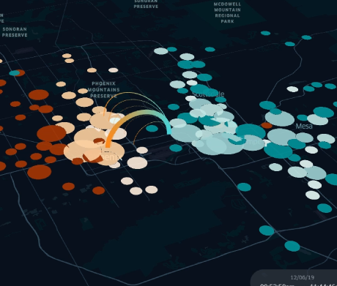
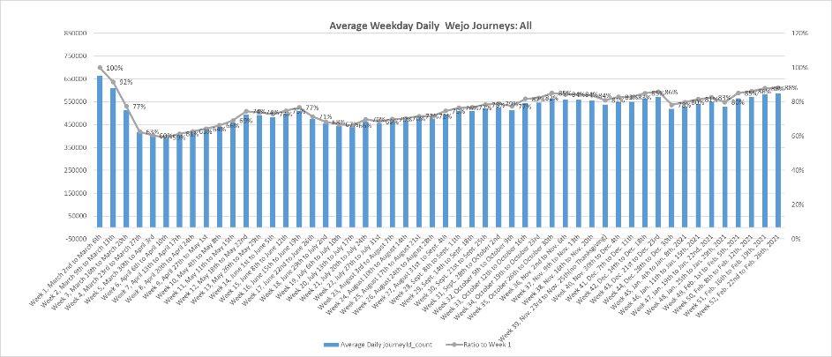
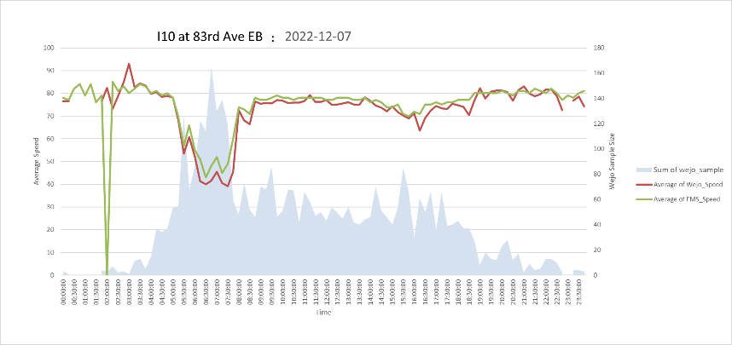
How MAG Uses Connected Vehicle (CV) Data on other Applications
Bottleneck study - queue, select link analysis
Trend analysis
Benchmark other mobility datasets
Model calibration –Macroscopic/Microscopic
Event data
49

Slide 50
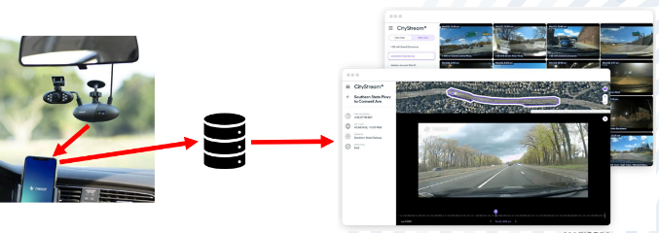
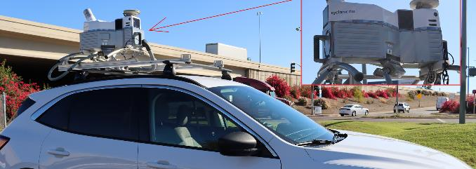
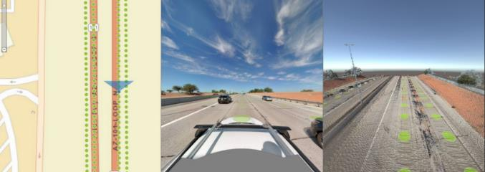
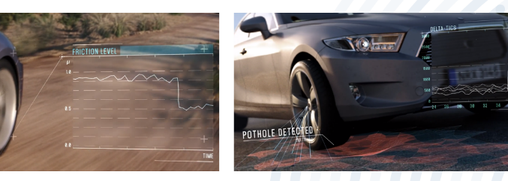
MAG Embraces Connected Vehicle Data and Other Crowdsourcing Technologies
Explore CV Data from other sources
Improve data processing efficiency
Truck GPS data/analytics from multiple sources
Other pilot efforts under MAG emerging tech program
Virtual camera for inspection, pavement conditions
Lidar for roadway inventory
Tire pressure sensor on pavement conditions

Slide 51
Contact
Wang Zhang, Ph.D.
Transportation Data Program Manager
Maricopa Association of Governments (www.azmag.gov)
Phoenix, AZ
wzhang@azmag.gov

Slide 52
Integrating Crowdsourced and Sensor-Based Data for Arterial Operations
Crowdsourcing for Operations Course, August 15, 2023
Jeremy Dilmore
Transportation Systems Management and Operation Engineer, Florida DOT

Slide 53
Arterial Data Sources
Florida District 5 arterial roadways have 1600 signalized intersections
900+ reporting ATSPM (2-minute frequency)
200+ have CCTV reporting turning movement counts
Crowd sourced data
GPS based subset of instrumented and reporting

Slide 54
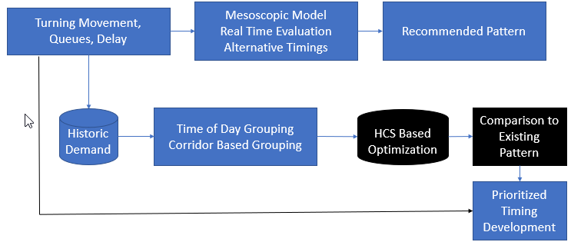
Improving Arterial Awareness
Fusing data provides coverage unobtainable with only instrumentation
Fused data then used manage whole system
Crashes, event driven demand
Retiming based on need

Slide 55
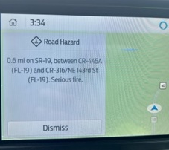
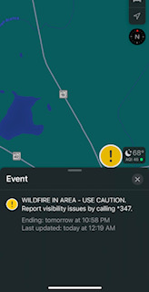
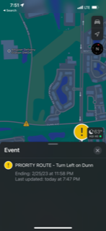
Improving Arterial Operations
Two Way Communication - Using applications to inform drivers during events such as rocket launches, Orlando venues, hurricanes, etc.
Safety Campaign
During Event
Wildfire
Event Routing
WILDFIRE IN AREA– USE CAUTION
PRIORITY ROUTE – TURN LEFT ON DUNN
EXPECT MAJOR DELAYS–
LOOK TWICE, SAVE A LIFE

Slide 56
Arterial Management Crowdsourcing Examples
Agency | How Data is Used | Data Source
Austin, TX | Performance-based retiming | INRIX®
Louisville, KY | Performance-based retiming Measuring improvement effects | Waze®
Lake County, IL | Continuous monitoring Proactive response Performance-based retiming | Waze® and ATSPM
Washington, DC | Performance-based retiming | INRIX®, Waze®, and ITS sensor data
https://www.fhwa.dot.gov/innovation/everydaycounts/edc_5/docs/crowdsourcing_applications.pdf

Slide 57
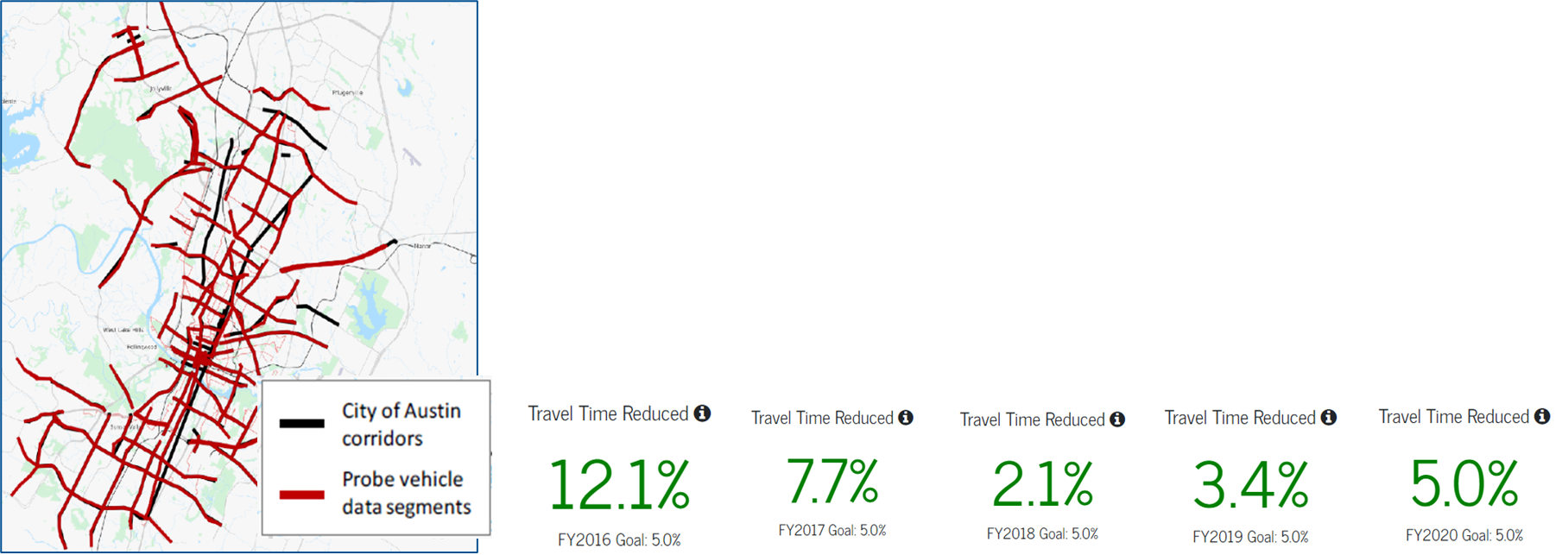
Example: City of Austin Shifts to Performance-Based Corridor Retiming
Previously retiming on rotating three-year schedule among ninety corridors.
Historic vehicle probe data used to prioritize annual retiming of approximately 30 percent of city signals.
Benefits of retiming shared with public.
Source: Port Authority of New York and New Jersey
Source: City of Austin

Slide 58
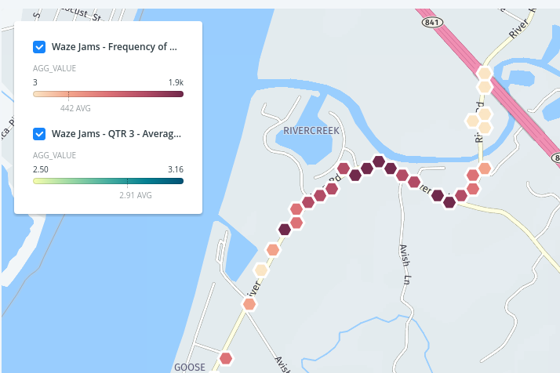
Example: Louisville Metro, Kentucky Crowdsources Signal Retiming Impacts
Archive and analyze Waze® jams data using PowerBI®.
Compares data before and after retiming rather than through a paid study.
Also use data for hot-spot analysis and detecting faulty intersection equipment.
Visual and Quantitative Jams Data
Source: Louisville Metro, Kentucky

Slide 59
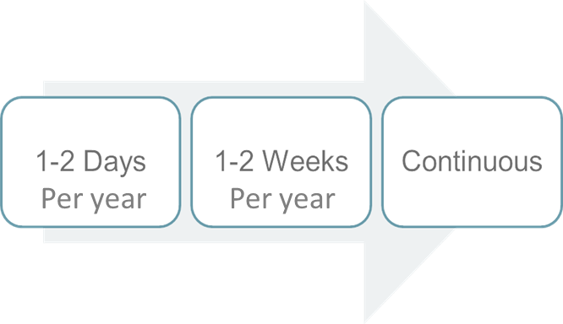
Example: Lake County Integrates Navigation Application Data for Signal Responsiveness
From manual, infrequent to automated, continuous data collection
Proactively implements alternate signal timing for crashes or adverse weather
Significant savings on signal coordination and timing studies
Travel Time, Delay, and Speed Data from Waze, Stops from Automated Traffic Signal Performance Measures
Source: Lake County DOT

Slide 60
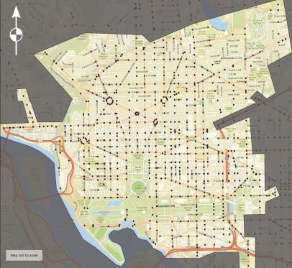
Example: Washington D.C. Uses Multiple Data for Corridor Retiming
600+ signal grid network with auto, bus, pedestrian, and bicycle considerations.
Used vehicle probe data through RITIS, Google® Traffic®, Waze®, floating car/GPS, bicycle travel time, and other data with a Synchro® simulation model to retime network.
Resulted in annual $2.4M mainline traffic delay savings, and annual $5.8M savings considering all traffic approaches.
Washington D.C., Traffic Signal Network
Source: District Department of Transportation

Slide 61
Knowledge Check
How does crowdsourced data improve arterial management?
Detection of faulty traffic signals
Performance-based corridor retiming
Assess impact of signal retiming
All the above
D. All of the above
Source: Unsplash

Slide 62
Question, Answer, and Discussion
Source: Pixabay.

Slide 63
Road Weather Crowdsourcing Resources
Adventures in Crowdsourcing webinars
with road weather content:
Social Media for Improved Operations
Engaging Navigation Providers
Using Crowdsourced Data for Traveler Information
Business Case for Crowdsourced Data
FHWA EDC-6 Crowdsourcing for Advancing Operation Resource Site (bit.ly/CS4Ops)

Slide 64
Arterial Crowdsourcing Resources
Adventures in Crowdsourcing webinars with arterial management content:
Traffic Signal Applications
Validating Crowdsourced Data
Eastern Transportation Coalition webinar:
Using RITIS for Arterial Performance Measures (Briefing)
FHWA Arterial Management Program
FHWA EDC-6 Crowdsourcing for Advancing Operation Resource Site (bit.ly/CS4Ops)

Slide 65
Crowdsourcing Beyond Every Day Counts Round Six
New website presence
Continue course delivery
Continue technical support
Continue free access to the EDC-6 Adventures in Crowdsourcing webinar series hosted by the National Operations Center of Excellence
Concept website in development and intended for FHWA Office of Operations.
Source: FHWA.

Slide 66
Thank you.
James Colyar
james.colyar@dot.gov
360‒753‒9408
Greg Jones
gregm.jones@dot.gov
404‒895‒6220
Ralph Volpe
ralph.volpe@dot.gov
404‒985‒1268

Slide 67
Upcoming T3 Webinars
Webinar | Date | Time
Crowdsourcing for Advancing Operations: Emergency and Work Zone Management and Next Steps | Tuesday, September 19, 2023 | 1:00 P.M. - 2:30 P.M. ET
Register: https://www.pcb.its.dot.gov/t3_webinars.aspx
To access the recording and past T3 webinars, visit:
https://www.pcb.its.dot.gov/t3_archives.aspx

Slide 68
Feedback
A link to a feedback questionnaire is provided in the chat pod. Please take a few minutes to fill it out – we value your input
To receive notifications of upcoming events, send an email to T3@dot.gov with “Add to mailing list” in the subject line
Thank you!

